Slide 1


22-23 MH 1037 PREP INSTRUCTIONS
LSF Health SYSTEMS

Slide 2

Statutory AUTHORITY (WHY)
All grant agreements and payments of Federal and State financial assistance require compliance with:
  Section 215.971, Florida Statutes (F.S.), subsection 215.971 (2)(c), F.S.
    Final reconciliation report must identify any funds paid in excess of the expenditure.
    State or Federal funds paid to the provider in excess of documented allowable expenditures must be returned to the state unless otherwise authorized by law.
Agreements with recipients of State Financial Assistance, even if awarded on a fixed price basis, must require:
  Compliance with Section 215.97, F.S. –(Single Audit Act)
  Compliance with Section 215.971, F.S.- (Agreements funded with Federal or State assistance)
Agreements (sub-awards) with sub-recipients of Federal Financial Assistance require compliance with:
  Uniform Administrative Requirements, Cost Principles and Audit Requirements for Federal Awards (also known as the Uniform Guidance), Code of Federal Regulations Title 2, Part 200 (2 CFR, Part 200).
  Any balance of unobligated cash that has been advanced or paid that is not authorized to be retained for other projects must be refunded to the federal government.

Slide 3
REQUIREMENTS (WHAT)
MANAGING ENTITIES (MEs)
Each SAMH provider must be given the total paid by Other Cost Accumulator (OCA) for each covered service and program project code, in addition to the Post Award Notice at the end of the year.
Any discrepancies identified should be resolved expeditiously so necessary adjustments can be made and reported to DCF, if necessary.
The CF-MH 1037 total revenues by covered services and project codes within each program received from MEs. This form must match the final expenditure reports submitted to DCF.
PROVIDERS
Substance Abuse (SA) and Mental Health (MH) entities (Providers) must use the form CF-MH 1037, as prescribed by rule FAC 65E-14, for the supplemental schedule in their annual audits and for submissions to MEs.
Form CF-MH 1037 requires the period to be on a July 1st through June 30th basis.
If Mental Health and Substance Abuse services are provided, both program must be displayed separately on form CF-MH 1037, due to state appropriation and federal grant funding for each program as they both are different.
Form CF-MH 1037 should be used as the supplemental schedule with the annual CPA Audit, post reconciliation. Any adjustments to the form identified by auditors or providers post reconciliation, should be communicated forthwith to the appropriate ME, disclosing the nature and requirement of the adjustment to determine the effect on the final reconciliation. MEs should report adjustments and justification to DCF.
Form CF-MH 1037 is required even if the single audit threshold of $750,000 is not met.

Slide 4
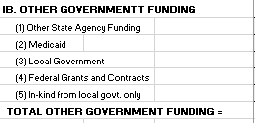
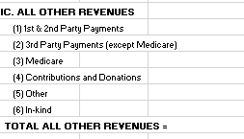
REQUIREMENTS (WHAT)
Please do not adjust any State revenue numbers in your 1037 forms.
Only complete the categories referenced below.
FOR PROVIDERS:
Providers are required to complete the following sections on their MH -1037 forms.
For Revenues:
Section IB: Other Government Funding by categories listed in the form..
Section IC: All other revenues by categories listed in the form.

Slide 5

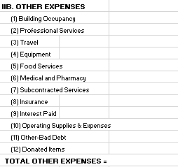

REQUIREMENTS (WHAT)
FOR PROVIDERS:
Providers are required to complete the following sections on their MH -1037 forms.
For Expenses:
Section IIA: Personnel Expenses by categories listed in the form,
Section IIB: All other expenses by categories listed in the form.
Section IIC: Distributed indirect costs by Support and Administration.
Section IID: Unallowable costs (if any)
Section IIE: Capital Expenditures (if any)
Please include ALL EXPENSES by each category & covered svc.

Slide 6
TIMELINE (WHEN)
October 31 : Provider 1037’s sent out
December 15 or before: 1037’s due to LSF from Providers
December 16 through 31 : LSF’s Review of 1037s submitted by providers and reallocation (if any) by LSF. 1037’s will be sent back to providers once reallocation is complete for final review and approval.
Review and discussion of reallocations submitted by LSF for approval by providers.

Slide 7
SCENARIOS (HOW)
Scenario | Assumption | Example
Surplus of funds in each covered service. State funding does not exceed allowable expenses but addition of other sources of revenue take revenues higher than expenditures. | Provider can apply all allowable expenses to state funding "first“. | $800K in state funds, $600K in other Revenues, equals $1,.4M in total funding. $1M in expenditures. Provider does not have a payback. Please see example 1.
State funding exceeds allowable expenses for a given covered service. | For each OCA, funding can be moved to any other covered service that used that same OCA, up to the total allowable expenses for the covered service. | Please see example 2
More than one OCA are spent on the given covered services. | Provider's discretion to be applied on payback (if any) from each OCA. | Please see examples 3 & 4.
Other funding sources are included in the covered service. | State funding can be applied to all allowable expenses. In other words, none of the other funding would be considered when calculating provider payback. | Please see example 5
Reallocation & Payback | Over-earning reallocated between allowable OCAs and reallocation not possible within 1 OCA and Covered Service due to over-earning. | Please see example 6

Slide 8
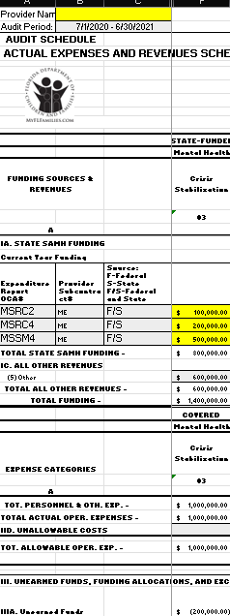
SCENARIOS (HOW)
Example 1:
Provider SAMH Funding: $800,000 over 3 different OCAs
Provider Other Revenues: $600,000
Total Revenues: $1,400,000
Total Expenses: $1,000,000
Result: No Payback as provider expenses exceed total SAMH funding.
$800,000 less $1,000,000 = ($200,000) over earned.

Slide 9
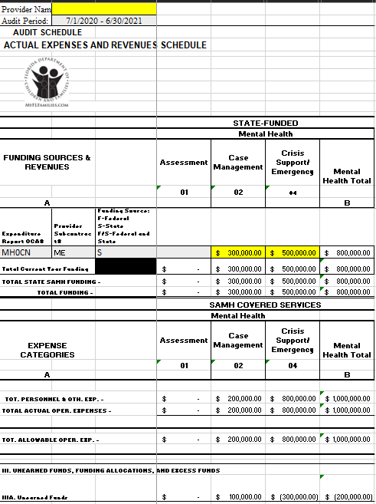
SCENARIOS (HOW)
Example 2:
State funding for SAMH under 2 covered services: $300,000 for Case Management and $500,000 for Crisis Support/Emergency in the same OCA MH0CN
Total expenses under both covered services: $200,000 for case management and $800,000 for Crisis Support/Emergency
Result: Under-earned (Surplus) in Case Management and Over-earned (Deficit) in Crisis Support/Emergency
Net Result: No payback as reallocation possible between covered services under the same OCA MH0CN.
Example 2:
Provider SAMH Funding: $500,000
Provider Other Revenues: $600,000
Total Funding: $1,100,000
Total Expenses: $1,000,000
Result: No Payback as provider expenses exceed total SAMH fundin

Slide 10
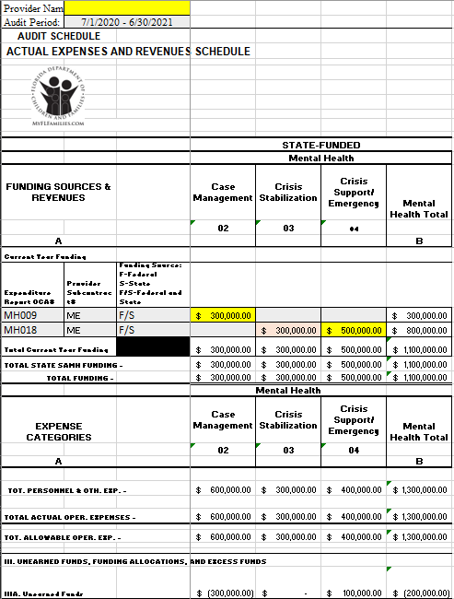
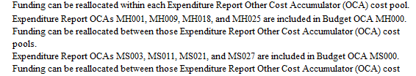
SCENARIOS (HOW)
Example 3:
State funding for SAMH under 3 covered services: $300,000 for Case Management, $300,000 for Crisis Stabilization and $500,000 for Crisis Support/Emergency in 2 different OCAs MH009 & MH018
Total expenses under all 3 covered services: $400,000 for case management, $300,000 for Crisis Stabilization and $400,000 for Crisis Support/Emergency
Result: Over-earned (Deficit) in Case Management, Breakeven in Crisis Stabilization and Under-earned (Surplus) in Crisis Support/Emergency in 2 different OCAs.
Net Result: No payback as reallocation possible even if they are in 2 different covered services and 2 different OCAs. Please refer to Instructions tab in your 1037 form under section IIIB.
Example 2:
Provider SAMH Funding: $500,000
Provider Other Revenues: $600,000
Total Funding: $1,100,000
Total Expenses: $1,000,000
Result: No Payback as provider expenses exceed total SAMH funding.

Slide 11
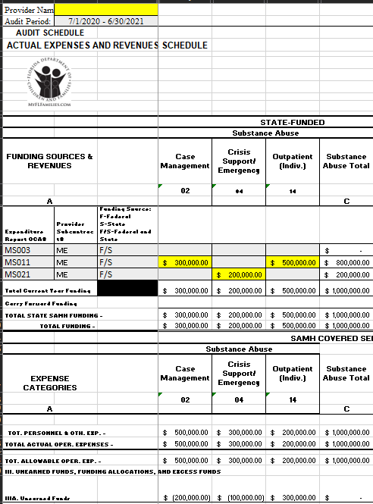
SCENARIOS (HOW)
Example 4:
State funding for SAMH spread over multiple covered services but between 3 OCAs, MS003, MS011 and MS021
Expenses exceed revenues for 2 covered services and do not for 1 covered services.
Since we are allowed to reallocate funds between MS000 OCAs i.e., MS003 and MS021 as illustrated in the above slide for multiple covered services.
Net Result: No payback as reallocation possible even if they are in multiple covered services and 3 different OCAs.
Please refer to instructions tab in your 1037 form under section IIIB.
Example 2:
Provider SAMH Funding: $500,000
Provider Other Revenues: $600,000
Total Funding: $1,100,000
Total Expenses: $1,000,000
Result: No Payback as provider expenses exceed total SAMH funding.

Slide 12
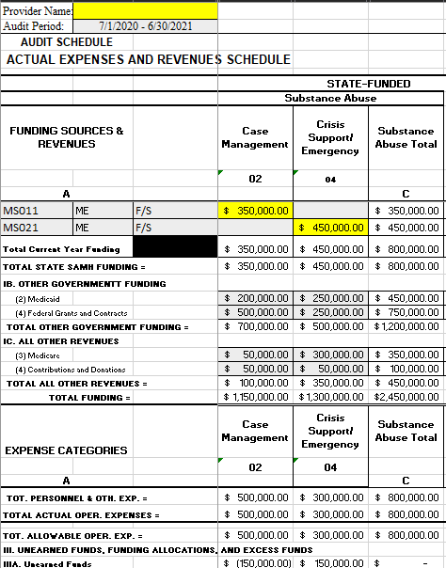
SCENARIOS (HOW)
Example 5:
State funding for SAMH in 2 covered services and 2 OCAs for $350,000 and $450,0000 respectively.
All other revenues recorded in Sections IB and IC.
Expenses for the 2 covered services recorded as $500,000 and $300,000 respectively.
Net Result: No other revenue sources from Section IB and IC are included in the calculation for unearned funds as evident.
$350,000 less $500,000 = $150,000 over-earned (deficit)
$450,000 less $300,000 = $150,000 under-earned (surplus)
Example 2:
Provider SAMH Funding: $500,000
Provider Other Revenues: $600,000
Total Funding: $1,100,000
Total Expenses: $1,000,000
Result: No Payback as provider expenses exceed total SAMH funding.

Slide 13
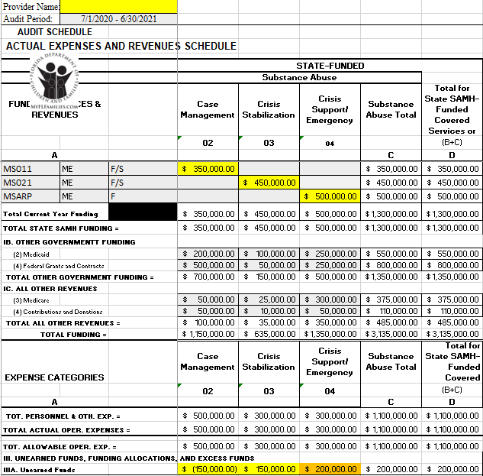
SCENARIOS (HOW)
Example 6:
State funding for SAMH in 3 covered services and 3 OCAs for $350,000, $450,0000 and $500,000, respectively.
All other revenues recorded in Sections IB and IC.
Expenses for the 3 covered services recorded as $500,000, $300,000, $300,000 respectively.
Net Result:
$350,000 less $500,000 = $150,000 over-earned (deficit) in Case Management.
$450,000 less $300,000 = $150,000 under-earned (surplus) in Crisis Stabilization.
$500,000 less $300,000 = $200,000
Under-earned (surplus) in Crisis Support Emergency.
Reallocation possible between Case Management and Crisis Stabilization because of allowable OCAs (MS011 and MS021) leading to NO PAYBACK.
Reallocation NOT possible due to funding in only one OCA (MSARP) and one Covered Service - Crisis Support Emergency leading to a PAYBACK of $200,000.
Example 2:
Provider SAMH Funding: $500,000
Provider Other Revenues: $600,000
Total Funding: $1,100,000
Total Expenses: $1,000,000
Result: No Payback as provider expenses exceed total SAMH funding.

Slide 14
1037 Quick Guide
Each section below must be completed.
Expenses
(By covered service)
Revenues
Expenditures reported should:
cover from July 1st, 2022 through June 30th, 2023.
be separated by Mental Health & Substance Abuse covered services.
include ALL your expenditures reported by covered services.
The amounts reported on your 1037 reconciliation should match your audited financials.
IID: Unallowable costs (if any)
IIE: Capital Expenditures (if any)

Slide 15
Q & A Session
For additional questions or concerns, please send an email to grantsjax@lsfnet.org or call us at (904) 337 4055.

