Slide 1
Florida’s ROSC Transformation
Bryan Mingle, Recovery Oriented System of Care Specialist
LSF Health Systems, DCF Managing Entity
Nancy Rice, System of Care Manager – Substance Use and
State Opioid Response
ROSC logo: Florida Department of Children and Families Communications Office

Slide 2
WHY ARE WE HERE?
To recognize that, despite many difficult and life-changing experiences, recovery is possible for people with mental health and/or substance use conditions.
Working together, providers and communities can shift from a system of acute care management to a system focused on recovery and wellness.
Notes:
We know that people with mental health and substance use conditions benefit from a wide range of support and treatment, and it is critical that these are available to people of all ages and to those who may experience additional discrimination and disadvantage because of physical impairments, substance use problems, forensic history, learning disabilities, or their ethnicity, sexuality, or religion. A central question for any organization is whether this support and treatment helps the person to pursue their ambitions and make the most of their life. Therefore, the philosophy and principles guiding our work as behavioral health practitioners and the services provided are particularly important.

Slide 3
Today’s Objectives
Understand the goals of a Recovery Oriented System of Care
Review practical ways to transform
Learn how the Self-Assessment Planning Tool (SAPT) and the Recovery Self-Assessment surveys (RSAs) support ROSC system improvements
Provide instruction for implementing SAPT/RSA

Slide 4
A Brief History
The ROSC framework is supported by the Substance Abuse and Mental Health Services Administration (SAMHSA) to assist with the transformation of behavioral health service systems to a recovery orientation throughout the United States (SAMHSA, 2010)

Slide 5
President George W. Bush’s Freedom Commission on Mental Health, 2003
Key assessment in its report stated the U.S. mental health system is “fragmented and in disarray, leading to unnecessary and costly disability, homelessness, school failures and incarceration.”
REPORT RECOMMENDED:
Fundamentally transforming service delivery based on a vision of recovery.

Slide 6
SAPT (Self-Assessment Planning Tool) History
The SAPT was developed by a team of faculty, people with lived experience in mental illness/SUD and service providers at the University of South Florida’s Florida Mental Health Institute (2018)
The SAPT was developed under contract with Florida’s Medicaid Authority, the Agency for Health Care Administration (AHCA).
WHY: There had been no previous way to determine if the services in the Florida Medicaid Handbook were being delivered at an acceptable level, or in a way that helped people achieve their life goals.

Slide 7
Florida’s Emerging Shared Vision
ROSC Summit participants identified five priorities:
Collaborative service relationships
Cross-system partnerships
Community integration
Community health and wellness
Peer-based recovery support
Hope hope hope

Slide 8
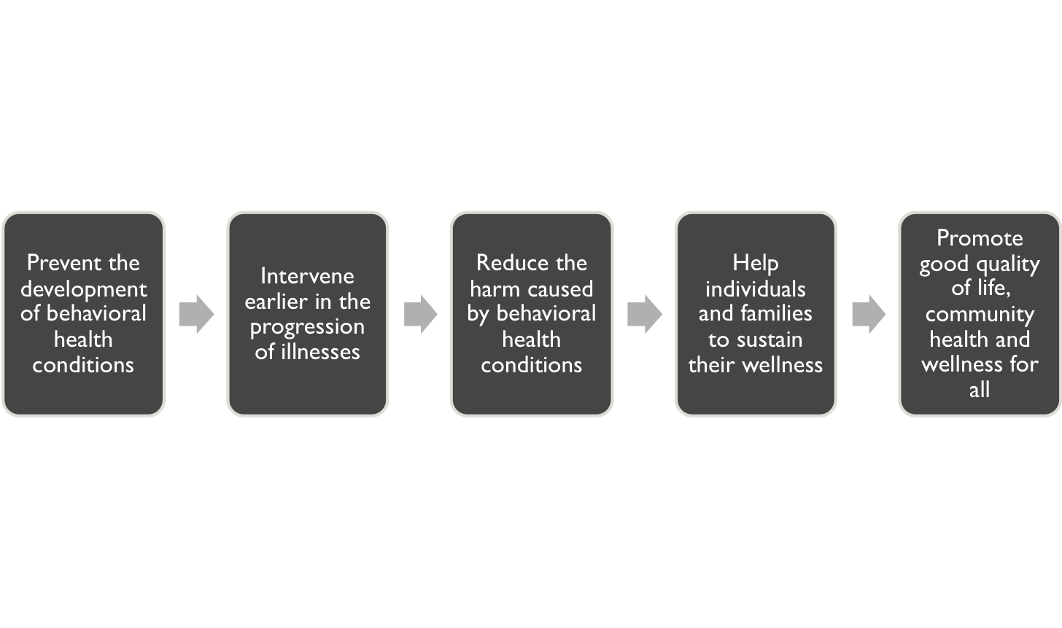
PRIMARY GOALS OF A ROSC
Notes:
Before we dive into the SAPT process, let’s step back and look at ROSC a bit more, a ROSC refresher course if you will…

Slide 9
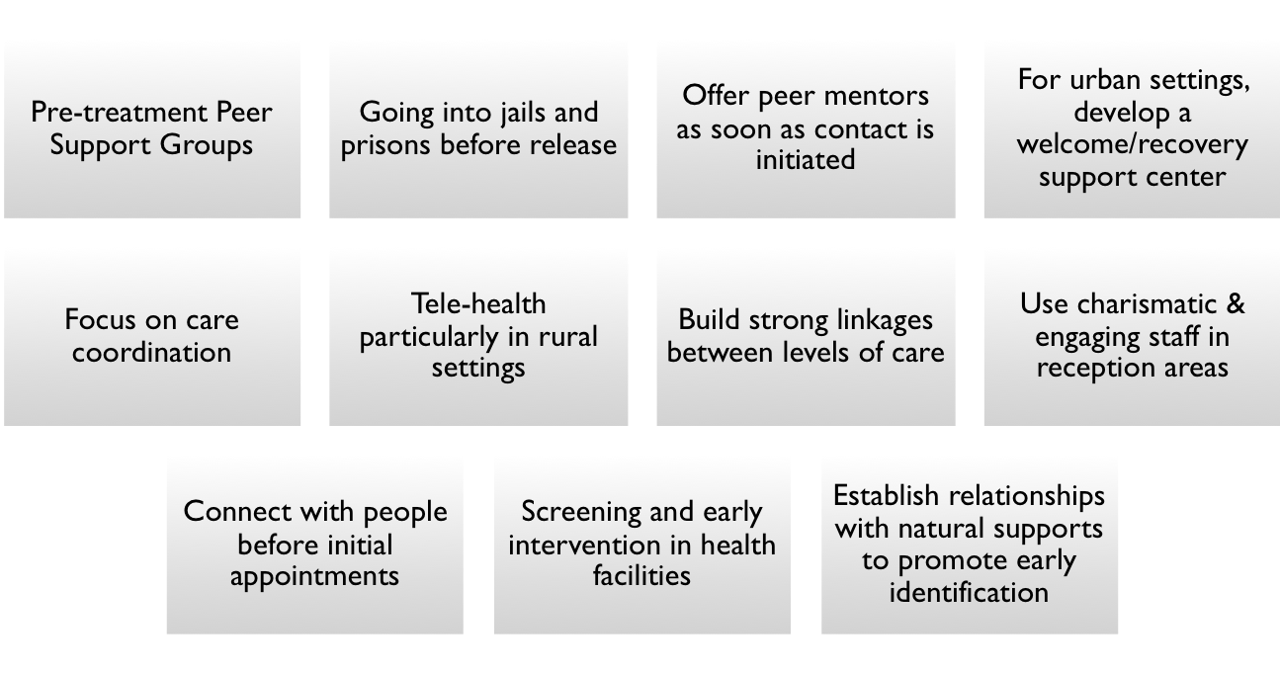
Strategies to Promote: Assertive Outreach and Engagement

Slide 10
7 Building Blocks of a ROSC
1. Developing a Shared Vision and Strengthening Cross-System Collaborations
2. Focus on Prevention and Early Intervention through Promotion of Population and Community Health
3. Fiscal Policy, Regulatory and Administrative Alignment

Slide 11
7 Building Blocks of a ROSC
4. Aligning Treatment with a Recovery-Oriented System of Care
5. Fully Integrating Peers and Other Recovery Support Services
6. Supporting the Development of a Mobilized Activated Recovery Community
7. Integrating Recovery-Oriented Performance Improvement and Evaluation

Slide 12
Integrating Peer Support Services = Positive Outcomes
Hope and
Resilience
Active roles in treatment
Health literacy
Overall satisfaction with services
Connection to community
Ability to cope with stress
Quality of life
Practical outcomes: housing, employment, finances

Slide 13
Self Assessment Planning Tool (SAPT)
50 questions organized under three domains
Administration
1. Philosophy
2. Continuous Quality Improvement
3. Outcome Assessment
4. Staff Support
5. Peer and Family Support
Treatment
1. Validation of the Person
2. Person-Centered Decision Making
3. Self-Care – Wellness
4. Advance Directives
5. Alternatives to Coercive Treatment
SAPT Survey

Slide 14
Self Assessment Planning Tool (SAPT)
Community Integration
1. Access
2. Basic Life Resources
3. Meaningful Activities and Roles
4. Peer Leadership
Four-point rating scale:
Respondents should be selected from senior administrative positions (leadership), clinical directors and select clinical staff, for example, a behavioral health tech in the CSU, a peer specialist.
Examine scores for each domain, program. Combine scores to establish a baseline of strengths and opportunities for growth.
Deploy SAPT at 12-month intervals

Slide 15
Planning and Implementation Guide
Use this to support Quality Improvement strategies
Provides practical suggestions for service practices
Presents resource references

Slide 16
Recovery Self-Assessment (RSA)
36-question RSA surveys are in 3 versions:
1) Person in recovery
2) Family member/advocate
3) Provider direct care staff
All are designed to gauge the degree to which programs implement recovery-oriented practices.
Links to all 3 versions will be emailed to you before Oct. 3. They will be in English and Spanish. QR Codes for you to place on flyers on-site also will be provided.

Slide 17
Survey Analysis
Providers will administer both the SAPT and RSA-R during the same time window. This allows agencies to have performance data from the perspective of both staff and persons served. LSF data staff will provide individualized reports.
Your ROSC Committee will identify areas where there are discrepancies between the perspectives of staff and persons served. This will help create QA action plans.

Slide 18
Timeline:
SAPT and RSA-R Deployment
Mid-September 2022: ROSC Point of Contact and/or agency QI Director receive links to SAPT and RSA person served, family/advocate surveys and their QR Codes; Spanish and English for RSA and English only SAPT
Oct. 3, 2022: SAPT and RSA Survey links open
Nov. 1, 2022: SAPT and RSA Survey links close
January 2023: LSFHS releases NSP reports
February – June 30, 2023: NSP ROSC committees use individual reports for action plan development (6 months)
During this timeframe, action plans to be emailed to bryan.mingle@lsfnet.org with the deadline being June 30, 2023.
Notes:
LSF data analysts will also generate a regional roll-up report with aggregate data of SAPR/RSA results. ALSO: We will provide you with action plan templates.

Slide 19
ROSC Resource Links
lsfhealthsystems.org/ROSC
SAPT Implementation Manual
RSA surveys
DCF Guidance Document 35

Slide 20
QUESTIONS
Reminder: LSFHS will schedule monthly technical assistance calls throughout remainder of FY 22-23; shared decision-making on the time.
For questions, contact Bryan Mingle at bryan.mingle@lsfnet.org (904-729-6681) or
Nancy Rice at nancy.rice@lsfnet.org
(904) 383-8012

