Slide 1

Focusing on Strengths and personal Responsibility
Module 6
Notes:
IN THIS NEXT MODULE OF OUR RECOVERY MANAGEMENT CURRICULUM WE ARE GOING TO EXPLORE Focusing on Strengths and personal Responsibility

Slide 2
Module 6 Outline
Learning Objective 1
Know and apply the strengths-based approach
1
Learning Objective 3
Learn skills and strategies to promote personal responsibility in recovery
3
Learning Objective 4
Describe how focusing on strengths and personal responsibility impact the recovery process
4
Learning Objective 2
Apply best-practices-Strengths-Based Approach and Person-Centered Planning to foster personal responsibility
2
Notes:
Review the learning objectives
The focus of this module is connecting the individual to their strengths so that they can take personal responsibility for their recovery journey.

Slide 3

Core principle
Focusing on Strengths and personal responsibility
Notes:
IN THIS NEXT SECTION WE ARE GOING TO EXPLORE
THE CORE PRINCIPLE OF Focusing on Strengths and personal responsibility.

Slide 4

Why Focus on Strengths and personal responsibility?
Doing so supports….
  Resilience
  and the capacity for
  Personal responsibility
  Self-advocacy
  Positive change
Notes:
Take your time to introduce/elaborate on each reason that focusing on strengths and personal responsibility is important.
Resilience
Helping others identify their strengths can increase their motivation, hope, and ability to deal with challenges.
Personal responsibility
Identifying and acknowledging one’s own strengths helps build confidence. In Module 3 we discussed autonomy and self-determination.
Empowerment and self-confidence can help others to develop/take increased personal responsibility for their health and well-being.
This results in more of an active vs. passive role in treatment.
Self-advocacy
This can develop as a result of increased self-confidence and is a natural extension of personal responsibility of one’s own recovery.
Positive change
Success breeds success! Accomplishments are motivating!

Slide 5
Important considerations
People generally share common hopes, needs, and responsibilities; however, each person will have a unique approach to achieving them.
  Each recovery journey is different.
Taking responsibility for one’s own health and well-being begins the recovery process.
People have the potential to recover, reclaim, and transform their lives.
  Sometimes people with behavioral health disorders are seen as unable to “get better.”
A focus on strengths and abilities motivates and contributes to building confidence and resilience.
Notes:
People generally share common hopes, needs, and responsibilities; however, each person will have a unique approach to achieving them.
Make the connection to person-centered approaches and individual choice. Each recovery journey is different.
Taking responsibility for one’s own health and well-being begins the recovery process.
Recovery is far more than just being compliant with treatment directives.
Recovery is holistic.
Explain that people have the potential to recover, reclaim and transform their lives.
This can even include staff!!!!
A focus on strengths and abilities motivates and contributes to building confidence and resilience.
Another way to reinforce the importance of these approaches.

Slide 6
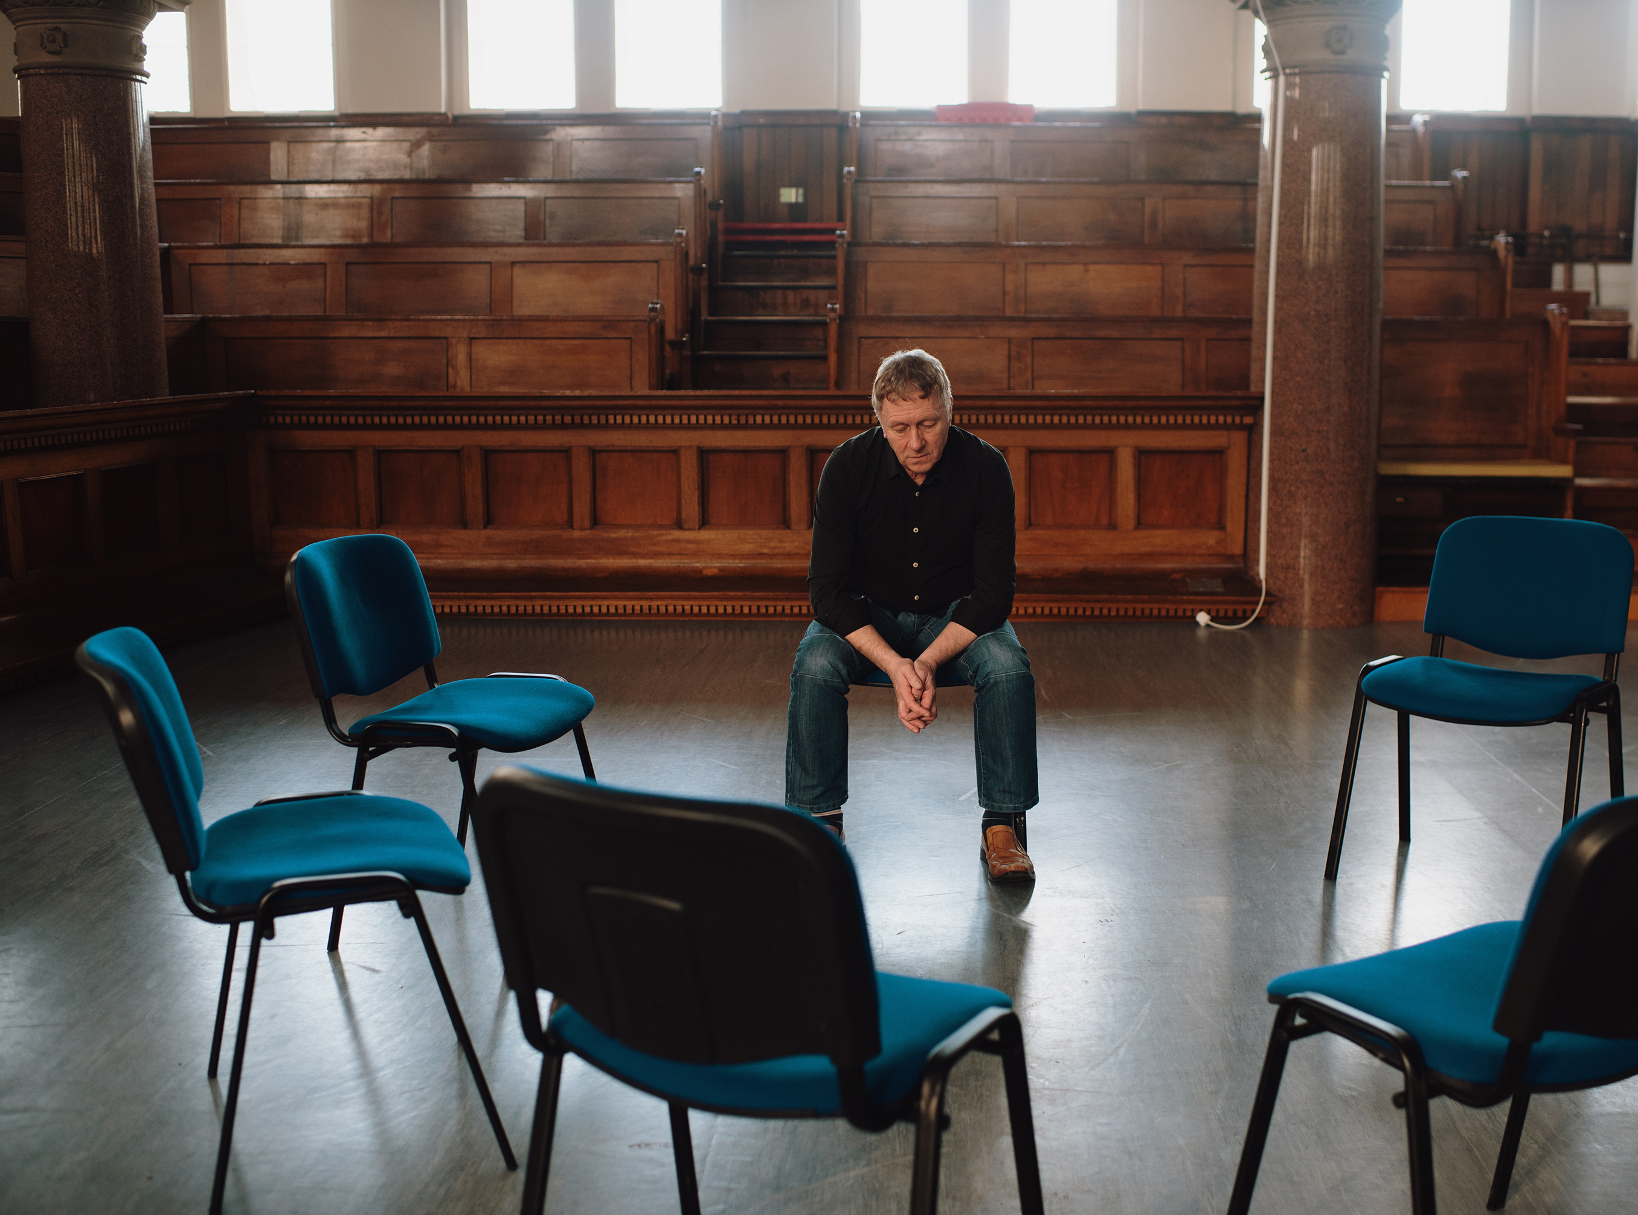
focusing on strengths and personal responsibility
Provides dignity, hope and resilience
Creates meaning in relationships and in life
Fosters healthy relationships
Improves self-efficacy
Notes:
Take your time to introduce/elaborate on each role that focusing on strengths and personal responsibility plays on recovery.
Providing dignity and hope to the individuals we serve will help them connect to resilience.
Dignity and hope helps the individual feel valued. By feeling valued, they can create meaning in relationships and in life.
As the individual develops healthy relationships, they begin connect to their strengths and improve self-efficacy.

Slide 7
Values & attitudes
Focusing on Strengths and personal responsibility
Notes:
IN THIS NEXT SECTION WE ARE GOING TO EXPLORE THE VALUES AND ATTITUDES THAT ARE NECESSARY TO PROMOTE
THE CORE PRINCIPLE OF Focusing on Strengths and personal responsibility.

Slide 8

Values and attitudes
Convey belief in people’s capacity to reach their goals and have a life rich in possibility and meaning
Acknowledge and positively reinforce people’s strengths and capacity for personal recovery
Provide a recovery plan that is focused on goals, aspirations, and self-management; extends beyond the primary course of treatment; and promotes long-term recovery
Provide an environment for customization and choice where the individual participates in planning and setting goals and objectives for their recovery
Mental Health Commission of Canada, 2015
Notes:
For approaches to be seen and felt as genuine, they need to originate from sincere beliefs.
Explore this as you present each of the following…..
Convey belief in people’s capacity to reach their goals and have a life rich in possibility and meaning.
We provide hope in their ability to reach their goals.
Provide an environment for customization and choice where the individual participates in planning and setting goals and objectives for their recovery.
Providing an environment for customization and choice provides an opportunity for the individual to participate in recovery planning that is designed to meet their unique needs.
Customization and choice allows for us to provide services that demonstrate considerable variation, reflecting efforts to address the individual’s mental, emotional, physical, spiritual, and cultural needs.
Acknowledge and positively reinforce people’s strengths and capacity for personal recovery.
Acknowledging and positively reinforcing strengths and capacity promote participation in life roles, achieved valued goals and aspirations, and self-manage recovery.
Provide a recovery plan that is focused on goals, aspirations, and self-management; extends beyond the primary course of treatment; and promotes long-term recovery.
The individual will have a plan that has services that are centered on the individual is focused on goals, aspirations and self-management.
The recovery plan ensures ongoing and seamless connections with services and supported for as long as the individual needs them.

Slide 9
it is important to uphold the belief that
Recovery is person-driven
Each of the individuals we serve defines their own life goals and designs their unique paths toward these goals
Each of the individuals we serve have the capacity to reach their goals
We are providing hope and helping them connect to building a person-driven life that creates meaning and possibility
Notes:
Emphasize that a recovery-oriented process is about fostering the individual’s belief in their ability to recover.
Recovery is person-driven
Requires setting goals and independently
We provide hope and help them to connect to ways they can foster a person-driven life and create meaning and possibility.

Slide 10
we must
Affirm each individual’s right to determine their own path to wellbeing and recovery
  Affirming this “individual” path does not imply that individuals are “on their own”
Continually reflect upon our own personal, professional, cultural values, and beliefs
Mental Health Commission of Canada, 2015
Notes:
Emphasize that there is a connection between our personal and professional values and fostering strengths and personal responsibility in the individuals that we serve.
The process requires a collaborative partnership.

Slide 11
What we know
Focusing on Strengths and personal responsibility
Notes:
IN THIS NEXT SECTION WE ARE GOING TO EXPLORE THE KNOWLEDGE BASE THAT IS NECESSARY TO PROMOTE
THE CORE PRINCIPLE OF Focusing on Strengths and personal responsibility.

Slide 12

needed Knowledge base
Understanding certain concepts is necessary in order to put into practice a focus on strengths and personal responsibility.
Know how to apply strengths-based approach
Demonstrate a collaborative process where the individual has a choice in guiding their recovery process,
Understand the concepts of resilience, personal strength, personal responsibility, recovery focus and hope
Notes:
Explain that efforts must be made to provide our individuals with opportunities and access to services that address their unique needs.
Know how to apply strengths-based approach.
The strengths-based approach indicates that treatment delivery and planning are oriented toward individual’s strengths rather than deficits.
Demonstrate a collaborative process where the individual has a choice in guiding their recovery process.
Recovery-oriented practice is about appreciating the rich diversity of the individuals that we serve.
Respecting choices that individuals make throughout their recovery process helps them determine what services will best meet their needs.
Understand the concepts of resilience, personal strength, personal responsibility, recovery focus, and hope
When we focus on their strengths and abilities, individuals will gain confidence and the resilience necessary for self-agency.
Through hope and respect, we begin to help individuals connect with their inherent resilience, support the growth and development of their capacities, and help them to become active participants in their recovery.
Now let’s take a closer look at what resilience is.

Slide 13
What is Resilience?
“In the context of exposure to significant adversity, resilience is both the capacity of individuals to navigate their way to the psychological, social, cultural, and physical resources that sustain their well-being, and their capacity individually and collectively to negotiate for these resources to be provided in culturally meaningful ways.”
“An individual’s ability to overcome adversity and continue his or her normal development.”
https://resilienceresearch.org
“Resilience is developed by engaging, rather than avoiding, life’s challenges’”
Mental Health Commission of Canada, 2015 pg., 34
Notes:
Take a moment to read each definition on resilience in recovery.
Share the following suggested definition by Dr. Michael Ungar, Co-Director of the Resilience Research Center:
“In the context of exposure to significant adversity, resilience is both the capacity of individuals to navigate their way to the psychological, social, cultural, and physical resources that sustain their well-being, and their capacity individually and collectively to negotiate for these resources to be provided in culturally meaningful ways.”
Explain that the concept of resilience is noted throughout this module and previous modules.

Slide 14
BEST PRACTICES IN
ROSC
Strengths-Based Approach
Person-Centered Recovery Planning
Shared Decision-Making Model
Notes:
This slide is meant to show how we move from the larger picture of the Recovery-Oriented System of Care to the individual.
Explain to the participants that we make this shift from principles to knowing what best practices are applied to foster strengths and personal responsibility.
Best practices create the environment for personal responsibility.

Slide 15
Strengths-Based Approach
The strengths-based approach indicates that treatment delivery and planning are oriented toward individual’s strengths and preferences rather than deficits.
The strengths-based approach in the recovery process is applied to the strengths-assessment and the recovery plans that are developed in collaboration with the individual served.
Notes:
Take time to review the definition that is bolded.
Point out that the strengths-based approach is applied to the strengths-assessment and in recovery planning.
Point out that the strengths-assessment was reviewed in Module 4 and recovery planning will be reviewed in the next section.

Slide 16
Examples of Personal Strengths
Courage
Resilience
Leadership
Teamwork
Clear communication
Strong work ethic
Humility
Empathy
Asks for help
Can you think of other examples of personal strengths?
Notes:
Review the examples of personal strengths.
Ask 2-3 volunteers to share other examples of personal strengths.
Share that the strengths-based approach motivates our individuals.
Share that the individuals we serve begin to feel good about themselves and build confidence and resilience to take action toward achieving their goals.

Slide 17
PERSON-CENTERED Recovery PLANNING
Is grown out of a culture that fully appreciates recovery, self-determination, and community inclusion (Tandora, 2016)
Is a co-created and written plan that outlines the individual’s most valued recovery goals and the approaches and recovery support services that are needed to achieve those goals
Is a collaborative process
Is person-driven
Notes:
Take time to review the definition in bold.
Share that the process of Person-Centered Recovery Planning is collaborative and is person-driven.
Share that the process is a co-created written plan.
Tandora, J. (2016). PowerPoint Person-Centered Recovery Planning: Partnering for Recovery in Behavioral Health. https://www.spokanecounty.org/DocumentCenter/View/22452/June-2016-Tondora-Spokane-PCP-Training-Series

Slide 18
The 4 Essential Ps in person-centered recovery planning
Philosophy-Core Values
Process-New ways of partnering
Plan-Concrete roadmap
Purpose-Meaningful outcomes
(Tandora, 2016).
Notes:
Take time to review the 4 Essential Ps in Person-Centered Recovery Planning.
Emphasize that the process of Person-Centered Recovery Planning is collaborative and is person-driven.

Slide 19
Shared Decision-Making model
Shared-decision making (SDM) is defined as: “An approach where clinicians and patients share the best available evidence when faced with the task of making decisions, and where patients are supported to consider options, to achieve informed preferences” (Elwyn, G. 2010)
  Aims to help people have informed, meaningful, and collaborative discussions with providers about their health care services (SAMHSA, 2022)
  Shared-decisions are made in identifying approaches and support services that best meet the unique needs of the individual served
Notes:
Take time to review the definition in bold.
Explain that the Shared Decision-Making model is an emerging best practice in behavioral and physical health and is recognized by SAMHSA as a way to include the individual in their recovery process.
Share that the individual identifies approaches and support services that fit their unique needs.
SAMHSA.gov 2022 https://www.samhsa.gov/brss-tacs/recovery-support-tools/shared-decision-making
Elwyn G, Coulter A, Laitner S, Walker E, Watson P, Thomson R. Implementing shared decision making in the NHS. BMJ. 2010;341:c5146. doi: 10.1136/bmj.c5146.

Slide 20
Shared Decision-Making involves
Tools and Resources that offer objective information
(SAMHSA, 2022)
The Individual as an integral part in treatment/service and recovery planning
Collaboration to make the best plan for their needs and situation
Notes:
Take time to review the concepts.
Shared Decision-Making involves
The Individual
Tools and Resources
Collaboration
SAMHSA.Gov (2022)https://www.samhsa.gov/brss-tacs/recovery-support-tools/shared-decision-making
Elwyn G, Coulter A, Laitner S, Walker E, Watson P, Thomson R. Implementing shared decision making in the NHS. BMJ. 2010;341:c5146. doi: 10.1136/bmj.c5146.

Slide 21
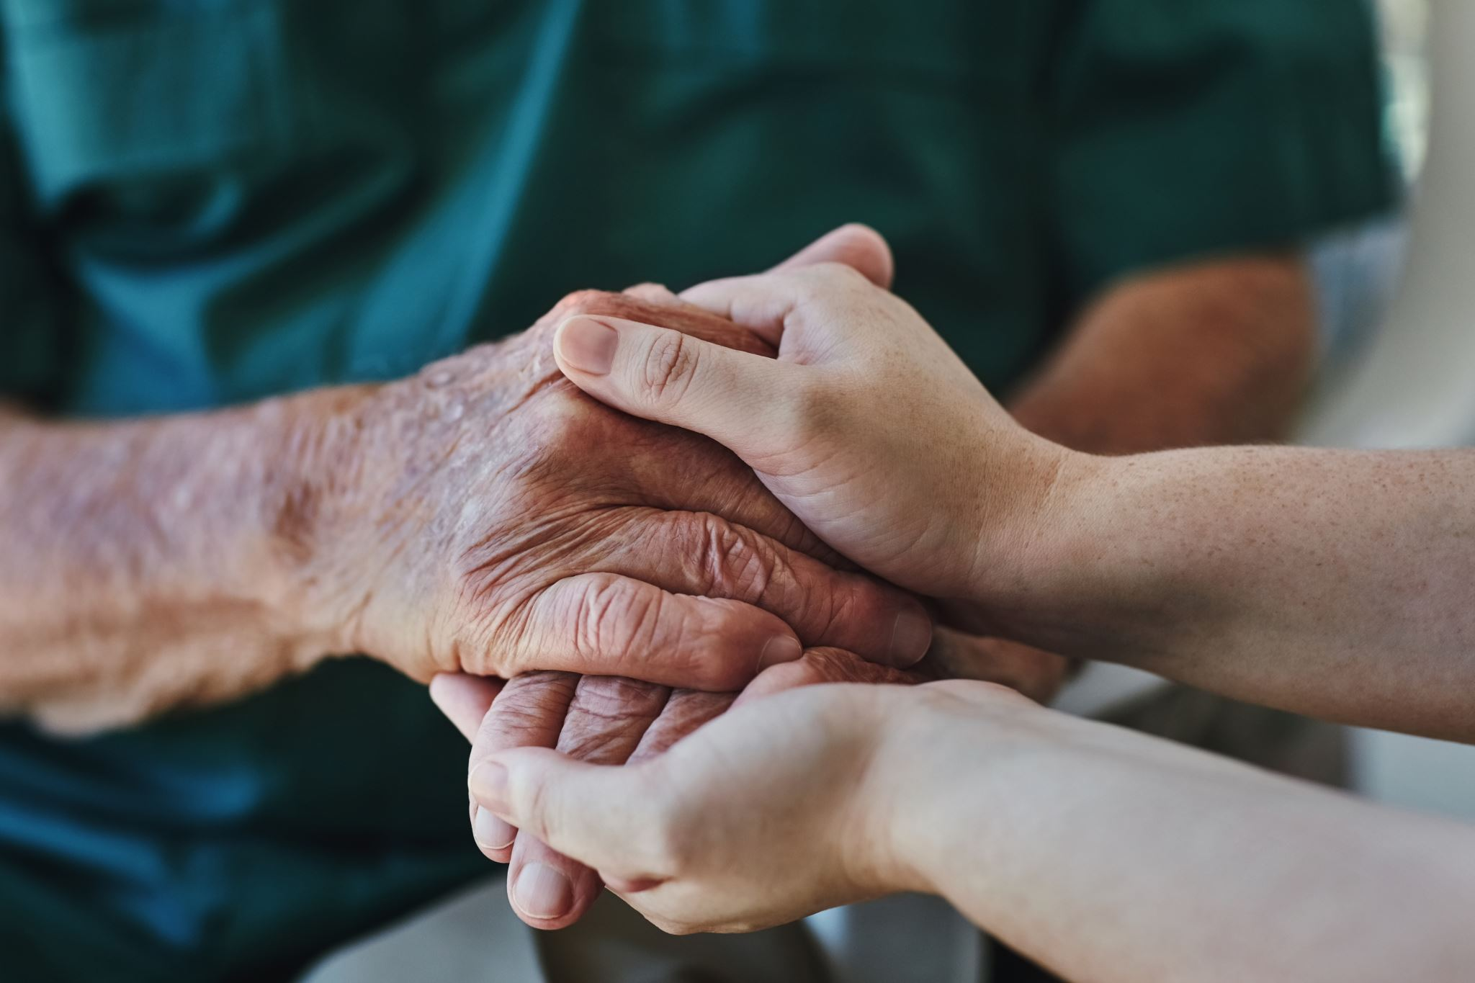
The role of Shared Decision-Making in fostering personal responsibility
Helps provide access to services that fit the unique needs of the individual
Is strengths-based and recovery-focused
Makes the individual an integral part of their recovery journey
Notes:
Helps provide access to services that fit the unique needs of the individual.
Recovery-oriented services do not prescribe a predetermined definition or expectation of the individuals that we serve.
We do not attempt to “fix” others.
Adopting a recovery-oriented approach builds upon the belief that the individuals we serve will recover.
Is strengths-based and recovery-focused.
Consideration of choice, responding to basic needs and the unique needs of our individuals, and having access to services that fit these needs, helps individuals become responsible for their recovery.
Makes the individual an integral part of their recovery journey.
Personal responsibility begins with believing that the individual has potential to personally transform their life.
We do this by aligning with the individual.

Slide 22
Individuals participate in their personal recovery by:
Setting goals, aspirations and self-management support services that address their unique needs and is personal to their recovery narrative
Being actively involved in recovery planning, attending meetings, groups, and other support services
Focusing on personal strengths
Focusing on their personal responsibility in their recovery journey
Attending the full array of services that are available to them
Notes:
Share with the participants that there is a connection between personal responsibility, recovery planning, and recovery.
Highlight the following points that are provided under each bulleted point.
Setting goals, aspirations and self-management support services that address their unique needs and is personal to their recovery narrative.
Identifying and setting goals that are unique to them promotes choice and self-determination.
Being actively involved in recovery planning, attending meetings, groups, and other support services.
An active involvement in recovery planning, attending meetings, groups, and other support services creates an opportunity for the individual to become an integral part of their own recovery journey.
Attending the full array of services that are available to them.
By attending the full array of services that are available to them, the individual connects to their personal responsibility for their own self-care journey to recovery.
Focusing on personal strengths.
Collaborative, person-first planning, and approaches that focus on personal strengths, helps the individual to build upon these strengths to create meaning in their lives and in their recovery journey.
Focusing on their personal responsibility in their recovery journey.
Share with the participants that the concepts of self-determination, personal responsibility, and self-management and the goals of reclaiming control and choice are pivotal to their recovery journey.

Slide 23
Application to practice
Focusing on Strengths and personal responsibility
Notes:
IN THIS NEXT SECTION WE ARE GOING TO EXPLORE HOW
THE CORE PRINCIPLE OF Focusing on Strengths and personal responsibility IS PUT INTO PRACTICE.

Slide 24
Personal Responsibility and the role of the service provider
When the service provider | The individual served will engage by
builds a therapeutic alliance. | feeling supported, valued, and heard.
engages in the therapeutic process by focusing on autonomy, building trust, listening to concerns, and offers opportunities to engage in the decision-making process. | participating openly in assessments and planning, and taking personal responsibility in symptom management, trigger management, and building a support system.
focuses on the whole person to include goals, strengths, and interests. | having an interest in their recovery process.
Notes:
Take a minute to review the Personal Responsibility and The Role of Service Provider slide.
Point out that when the service provider is an active partner and collaborates with the individuals served, the individual will become active in taking personal responsibility.
We model personal responsibility by taking personal responsibility in our role as a service provider.
We align with the individual and focus on autonomy and trust.
We do this through empathy, being genuine, and collaboration.

Slide 25
Personal Responsibility and the role of the service provider
When the service provider | The individual served will engage by
embodies characteristics that provide a strong foundation to the therapeutic alliance (empathy, confidence, flexibility, genuineness, engagement, attentiveness, skill, and respect). | connecting to self-determination and autonomy and begin to make healthier choices in their recovery.
collaborates with other community agencies and providers. | building a stronger recovery support system and recovery community.
Notes:
Take a minute to review the Personal Responsibility and The Role of Service Provider slide.
Point out that when the service provider is an active partner and collaborates with the individuals served, the individual will become active in taking personal responsibility.
We model personal responsibility by taking personal responsibility in our role as a service provider.
We align with the individual and focus on autonomy and trust.
We do this through empathy, being genuine, and collaboration.

Slide 26
When we are Recovery-Focused and Strengths-based, we
Attend
Attend to diverse needs by assessing for basic needs and provide access to multiple interventions, approaches, and services that address those needs
Empower
Empower the individual to take personal responsibility for recovery, including self-management of symptoms, monitoring triggers, and identifying environmental stressors and warning signs
Offer
Provide recovery education tools, peer support, and access to a full-service array of services to compliment preferences, needs, and strengths of the individuals
Mental Health Commission of Canada, 2015 pg., 34
Notes:
Emphasize that when we are recovery-focused and strengths-based, we attend, empower and offer:
Attending-We attend to the diverse needs by providing multiple interventions
Empowering-We empower by helping the individual identify ways to manage symptoms, monitor triggers and identify environmental stressors and warning signs
Offering-We offer recovery education tools that fit the individual’s diverse needs
Explain that individuals do not become and stay involved with the behavioral health service delivery system because of prior experiences and/or fears of judgment, stigma, and discrimination.

Slide 27
Skills to Promote Personal Responsibility
Use coaching and motivational techniques to help individuals connect to their strengths
Explore goals, aspirations, and a recovery path with the individual and provide access to those services
Foster belief in the ability to recover
Demonstrate confidence in the individual’s strengths and skills in all parts of their life
Provide a Recovery Plan that is focused on goals, aspirations, and self-management of symptoms
Offer education, tools, and access to services to promote behavioral well-being, and recovery
Notes:
Take a minute to review the slide.
Point out the skills that are used to promote personal responsibility.
Part of supporting personal responsibility is to help individuals connect to their strengths.
Attending to the diverse needs and providing multiple interventions and access to services helps the individual maintain choice.
Personal responsibility occurs in a safe and welcoming environment.
Placing the person-first, focusing on strengths, and being recovery-focused will promote and strengthen personal responsibility.

Slide 28
We can promote personal responsibility By
Being non-judgmental
Making the individual an integral part of recovery planning
Acknowledging (with personal consent) the defined family care givers, and circles of support of the individual
Actively working with the support system to be part of the planning process
Offering access to recovery support services
Assisting in identifying peer support and other supportive recovery resources
Notes:
Emphasize that to foster personal responsibility, we are recovery and strengths-based focused.
Share that we must be non-judgmental and encourage individuals to self-advocate, connect to their strengths, and feel valued.
We must honor individuals by actively working with their support system and providing multiple events that enhance recovery.

Slide 29
add Choice and personal responsibility
Supporters and providers may not always agree with the choices individuals make.
Honoring choices does not mean ignoring harmful risks or minimizing safety, but allowing for each individual’s strengths, personal experiences, priorities, and preferences as part of the treatment/service and recovery plan.
Honoring choice helps the individual take personal responsibility for their recovery.
Mental Health Commission of Canada, 2015
How will you support the individual’s personal choice, if it does not align with your choice?
Notes:
Supporters and providers may not always agree with the choices individuals make.
Personal choice may conflict with choice of the service provider.
Honoring choices does not mean ignoring harmful risks or minimizing safety, but allowing for each individual’s strengths, personal experiences, priorities, and preferences as part of the treatment/service and recovery plan.
We must focus on personal choice and personal responsibility.
Honoring choice helps the individual take personal responsibility for their recovery.
How will you support the individual’s personal choice, if it does not align with your choice?
Identify two-three participants willing to respond to the question.

Slide 30
Applying the concepts
Strengths and personal responsibility can be applied by creating a recovery plan.
The recovery plan fosters personal responsibility by encouraging active participation in preferences for treatment and services.
The individual connects to personal choice, autonomy, and resilience.
Notes:
Explain the main points on the slide.
Emphasize that as practitioners, we connect what is already being done and how each person can play a personal role in their recovery.

Slide 31




Personal Responsibility through Recovery Planning
Recovery plan
Promotes personal responsibility
Provides access to services to meet the basic and unique needs of the individuals that we serve
Facilitates a structured, reliable source of tools to promote safety and well being to keep the individual on track
Notes:
Recovery Plan: Recovery plan is clearly labeled as a recovery plan and is focused on goals, aspirations, self-management, and other items that promotes long-term recovery.
Promotes Personal Responsibility: Provides access to services to meet the basic and unique needs of the individuals that we serve.
Recovery planning places the individual at the center and is integral to developing the recovery plan.
Facilitates a structured, reliable source of tools to promote safety and well being to keep the individual on track.
Emphasize that writing out a formal, detailed plan, improves chances of sustaining recovery.

Slide 32
In Recovery Planning We Consider
The role of provider in encouraging the individual to identify tools that promote safety, recovery, and wellbeing
The role of the individual in taking personal responsibility for accessing the services that are provided
How the individual’s strengths play a significant role in personal responsibility
Notes:
The role of provider in encouraging the individual to identify tools that promote safety, recovery, and wellbeing.
Our role is to encourage the individuals that we serve to be active participants in goal and objective setting and identifying services.
The role of the individual taking personal responsibility to access the services that are provided.
Recovery planning is the wellness tool used to increase safety; help monitor symptoms and environmental stressors that may throw them off track; and prove a plan to promote forward movement in their recovery.
How the individual’s strengths play a significant role in personal responsibility.
Individual’s personal strengths contribute to goals and aspirations for recovery.

Slide 33
reword a Recovery Plan to
Connect
Connect to recovery narrative
Identify
Identify strengths, needs, and preferences
Participate
Participate in shared decision-making to foster personal responsibility
Notes:
Use this slide to anchor the concept that recovery planning fosters engagement, connects the individual to personal responsibility, and makes for strong recovery planning.
Emphasize the words: Connect-Identify-Participate
The Therapeutic Alliance or therapy relationship makes substantial and consistent contributions to treatment outcomes independent of the type of treatment.
Shared Decision-Making supports maximum self-determination in the person-centered planning process; it is also used to discuss a variety of treatment alternatives that can be applied.

Slide 34
constructing the recovery plan
Gain an understanding of personal recovery
Introduce the purpose and structure of a recovery plan
Emphasize personal choice and options for the recovery process
Include relevant support systems in the development of the recovery plan
Identify needs, strengths, and assets through discussion
Notes:
Highlight the following statements:
People can benefit from having a written plan to guide their personal recovery journey, which can be referred to as a recovery plan.
The recovery planning process and the product or plan should be the heart and soul of a recovery-oriented partnership between individuals and providers.

Slide 35
constructing the recovery plan
Address the whole person (personal, social, health, employment, education, housing, cultural, and spiritual)
Assess strengths, resources, background, dreams, goals, and progress towards recovery
Assess progress towards recovery throughout the recovery journey as needed
Notes:
Highlight the following statements:
People can benefit from having a written plan to guide their personal recovery journey, which can be referred to as a recovery plan.
The recovery planning process and the product or plan should be the heart and soul of a recovery-oriented partnership between individuals and providers.

Slide 36
Recovery planning Examples of Recovery Plans
The Wellness Recovery Action Plan (WRAP®)
Whole Health Action Management (WHAM)
Wellness Tracker
Recovery Star
Mapping Your Recovery Journey
Notes:
HANDOUTS
Take a minute to briefly review each of the Recovery Plans.
Wellness Recovery Action Plan: Recovery Model developed by the Copeland Center. WRAP is a personalized wellness and recovery system rooted in the principle of self-determination.
Whole Health Action Management:
Developed by the National Council for Mental Wellbeing. Peer-led program that promotes self-management to create and sustain new health behavior.
Wellness Tracker:
Developed by the Depression and Bipolar Support Alliance to track symptoms, feelings, and overall mood and state of well- being.
Recovery Star:
Developed by the Association of Mental Health Providers is an outcomes measure which enables people using services to measure their own recovery progress, with the help of mental health workers or others.
Mapping Your Recovery:
Mapping Your Recovery Journey: A Peer-based Model that is a self-help, personal, fill-in-the-blanks journal helps the individual plan out their recovery, and see the progress that is made. This guide is designed to be used in conjunction with a mentor or sponsor. It offers a series of MAPS to help the individual understand thinking errors, build on your strengths, and overcome obstacles.

Slide 37
focusing on strengths and personal responsibility
In Application and Practice
Requires skills in planning and delivery of all services and supports
Biopsychosocial Assessment
  Requires clear information detailing a holistic account of the individual
  Requires accurate accounts of “where the individual is at” at a particular time in order to provide baseline information for treatment/service and recovery planning
  Requires complete and detailed information on support network, who the individual identifies as family, and determines the basic needs of the individual
Notes:
Emphasize to the participants that there are tools and resources that help us provide customization and choice for the individuals served.
The tools and resources provide details and insight into the individual’s life and help us deliver effective services in critical points in the planning and delivery of services.
In a Biopsychosocial assessment all sections need to be completed and provide clear and concise details of the individual’s history, challenges, and barriers in treatment.

Slide 38
focusing on strengths and personal responsibility
In Application and Practice
Requires skills in planning and delivery of all services and supports
Strengths Assessment
  Requires clear, personal statements on the individual’s personal strengths, needs, abilities, and preferences
  Requires completed and detailed statements that are person-driven
Notes:
Emphasize to the participants that there are tools and resources that help us provide customization and choice for the individuals served.
The tools and resources provides details and insight into the individual’s life and help us deliver effective services in critical points in the planning and delivery of services.
The strengths assessment must be Person-Driven and include personal statements on strengths, needs, abilities, and preferences.

Slide 39
focusing on strengths and personal responsibility
In Application and Practice
Requires skills in planning and delivery of all services and supports
Treatment/Service Planning
  Requires collaboration
  Is person-driven
  Applies the decision-making model
  Demonstrates that the identified goals and objectives are unique to the individual
  Identifies which service areas were derived from a collaborative process and that individual choice is guiding their treatment
  Indicates substantial variation with each area indicating individualization
  Displays tailoring of services to the individual
Notes:
Take a moment to review the skills required in treatment/service planning.
Emphasize to the participants that bulleted skills help us provide customization and choice for the individuals served.
The treatment/service planning is collaborative and applies the decision-making model.

Slide 40
focusing on strengths and personal responsibility
In Application and Practice
Requires skills in planning and delivery of all services and supports
Recovery Planning
  Is clearly labeled as a recovery plan
  Applies the 4 Ps in Person-Centered Recovery Planning
  Is focused on goals, aspirations, self-management, and recovery
  Promotes long-term recovery
  MUST be completed and not overlooked
Notes:
Emphasize to the participants that there are skills that help us provide customization and choice for the individuals served.
Emphasize that effective recovery planning promotes long-term recovery.

Slide 41
Questions for Reflection
Focusing on Strengths and personal responsibility
Notes:
IN THIS NEXT SECTION WE ARE GOING TO EXPLORE QUESTIONS FOR REFLECTION REGARDING
THE CORE PRINCIPLE OF Focusing on Strengths and personal responsibility.

Slide 42

Reflective practice
Please reflect on the following questions and write down your responses.
Direct Service provider: How is your practice responsive to individuals’ expectations, recovery goals, and unique needs?
Management: How do you draw on lived experience and encourage the co-design of policies and procedures?
Administrative: How do you support the agency to focus on strengths and personal responsibility?
Notes:
Review reflective questions.
Encourage the participants to reflect on the questions when they return back to their tasks.

Slide 43
Connect To Hope
Recovery-Oriented Principles (CONNECT)
Practices (HOPE)
PRINCIPLES
Create a culture and language and hope
Offer a comprehensive and holistic service array
Non-judgmental
Navigating diverse needs
Engagement strategies
Collaborative relationships and reflective practice
Transforming services and systems
PRACTICES
Honor the differences and diverse needs of each individual served
Offer various opportunities and resources that support the recovery journey
Provide an environment to encourage personal control
Engage in personal recovery by understanding personal recovery narrative in the treatment process and within the community
Notes:
Review that the acronym CONNECT to HOPE anchors us on focusing on strengths and personal responsibility.
Highlight that the principles are the essential components that reflect the beliefs and attitudes about a recovery-oriented system of care
and
The practices are how these principles “come to life” in order to facilitate a recovery-oriented system of care.
Review that recovery-oriented principles help us to connect to the individuals we serve by using meaningful engagement strategies and promoting a positive service culture focusing on
Create a culture and language and hope
Hope helps the individuals we service connect to recovery.
Non-judgmental
Non-judgment provides a space for individuals to connect to their personal strengths and personal responsibility.
Navigating diverse needs
Recovery planning assists with meeting the diverse needs of the individuals.
Provide an environment to encourage personal control
Personal control enhances personal responsibility.
The individuals we serve become active participants.

Slide 44
REFERENCES
Elwyn G, Coulter A, Laitner S, Walker E, Watson P, Thomson R. Implementing shared decision making in the NHS. BMJ. 2010;341:c5146. doi: 10.1136/bmj.c5146.
Mental Health Commission of Canada (2015). Recovery Guidelines Ottawa, ON.
Resilience Research Centre . Welcome - Resilience Research Centre
SAMHSA.gov 2022 https://www.samhsa.gov/brss-tacs/recovery-support-tools/shared-decision-making
Tandora, J. (2016). PowerPoint Person-Centered Recovery Planning: Partnering for Recovery in Behavioral Health. https://www.spokanecounty.org/DocumentCenter/View/22452/June-2016-Tondora-Spokane-PCP-Training-Series

Slide 45

THANK YOU!
Questions?

