Slide 1

Putting the Person First and Respecting Diversity of Needs
Module 4
Notes:
IN THIS NEXT MODULE OF OUR RECOVERY MANAGEMENT CURRICULUM WE ARE GOING TO EXPLORE
Putting the Person First and Respecting Diversity of Needs.

Slide 2
Module 4 Outline
Learning Objective 3
Clarify essential knowledge, attitudes, and skills that support an effective person-centered planning process.
3
Learning Objective 4
Identify organizational and staff responsibilities in the implementation of person-centered planning and care.
4
Learning Objective 2
Define the values that promote inclusivity and are critical to meeting the diversity of individual needs.
2
Learning Objective 1
Explore what it means to “put the person first.”
1
Notes:
This module will discuss putting the person first and respecting diversity of needs by introducing strategies for advancing person-centered planning and service delivery.

Slide 3

Core principle
Putting the Person First
and Respecting Diversity
of Needs
Notes:
IN THIS NEXT SECTION WE ARE GOING TO EXPLORE
THE CORE PRINCIPLE OF Putting the Person First and Respecting Diversity of Needs.

Slide 4

Why focus on Putting the Person First and Respecting the Diversity of Needs?
To meet the basic needs of the individuals we serve
To provide access to services that are related to the identified basic needs
To assess individual strengths and integrate these strengths into the achievement of treatment/service goals
To provide treatment and recovery planning that addresses the unique circumstances, history, needs, expressed preferences, and capabilities of each individual receiving services
Notes:
We put the person first and address the diversity of the individual’s needs to provide the best chance of recovery and overall quality of life.
We assess for basic needs and provide access to those services.
A strong assessment will provide opportunity for customization of treatment/service plans and most importantly allows for choice.
Individuals in recovery need to feel that staff responded positively to their unique needs and circumstances rather than requiring them to fit in with a uniform approach for service users.

Slide 5
Why focus on Putting the Person First?
Each person is a unique individual with the right to determine their own path towards health and well-being.
Recovery is an individual process – care and services are tailored to a person’s preferences, life circumstances, and aspirations which are integrated with their community of supports.
Everyone’s behavioral health and well-being is affected by multiple intersecting factors – biological, psychological, social and economic, as well as family context and cultural background, personal values, and spiritual beliefs.
Notes:
Person-first approaches ARE INCLUSIVE of respecting the diversity of the individual’s needs.
Person first approaches allow for customization and choice.
Addressing the multiple intersecting factors places the person first and at the center of their own recovery.

Slide 6
Why focus on Respecting the Diversity of Needs?
The starting point for recovery-oriented practice is to assess, plan, and deliver all services that first address basic needs such as shelter, food, medical, access to benefits, and safety.
Recovery-oriented practices acknowledge that not all groups have equal access to behavioral health services, supports, and treatments. Services seek to overcome the adverse impacts on behavioral health and well-being.
The unique circumstances, history, needs, expressed preferences, and capabilities are assessed to tailor services unique to the individual and their recovery.
Notes:
As providers we will be assessing for needs, strengths, and preferences.
Tailoring the services that best fit those needs, strengths, and preferences.
As providers we assess for and provide access to services that consider all groups so that they may have equal access to treatment and other services.

Slide 7




Respecting the Diversity of People’s Needs
It is essential to respect and be responsive to people at different stages of life, from diverse backgrounds and sexual orientations, of all religious beliefs and spiritual practices, language groups and communities, and those who live with physical disabilities.

Slide 8
Values & attitudes
Putting the Person First
and Respecting Diversity
of Needs
Notes:
IN THIS NEXT SECTION WE ARE GOING TO EXPLORE THE VALUES AND ATTITUDES THAT ARE NECESSARY TO PROMOTE THE CORE PRINCIPLE OF Putting the Person First and Respecting the Diversity of Needs.

Slide 9
Values and attitudes
Believe in the ability and right of a person to make their own life decisions.
View people in the context of their whole selves and lives.
Appreciate the complexity of needs and aspirations across cultural, spiritual, social, economic, emotional, and physical realms.
Accept that identity and personhood are not limited or defined by a person’s behavioral health status.
Mental Health Commission of Canada (2015)
Notes:
Believe in the ability and right of a person to make their own life decisions.
- Valuing the person’s ability and right to make their own decisions provides an environment that is person-driven.
View people in the context of their whole selves and lives.
Viewing the people in the context of their whole selves and lives is relational and supported by people who believe in their recovery.
Appreciate the complexity of needs and aspirations across cultural, spiritual, social, economic, emotional and physical realms.
- Recovery encompasses the individual’s whole life and the array of services and supports available should be integrated and coordinated.
Accept that identity and personhood are not limited or defined by a person’s behavioral health status.
Acceptance and appreciation for people affected by mental health and substance use challenges are crucial to achieve recovery.
Mental Health Commission of Canada (2015). Recovery Guidelines. Ottawa, ON.

Slide 10

Values and attitudes
Respect and accommodate diverse views on
  mental health and substance use challenges and barriers
  well-being
  treatment and services
Acknowledge personal beliefs as valid and relevant to behavioral health.
Recognize that individuals express their personal identities differently and have many ways of relating to others,
including family, community, and society.
Mental Health Commission of Canada (2015)
Notes:
As earlier modules have stressed, there are many pathways to recovery and the recovery journey is highly personalized.
Acknowledge personal beliefs as valid and relevant to behavioral health and recognize that individuals express their personal identities differently and have many ways of relating to others, including family, community, and society.
Acceptance fosters self-acceptance and empowerment to help individuals embrace their recovery and overcome occasional setbacks in their recovery.
The recovery-oriented approach addresses and seeks to overcome adverse impacts on behavioral health and well-being.
Putting the person first and respecting the diversity of people’s needs requires respect for the person at all different stages and parts of life.
Mental Health Commission of Canada (2015). Recovery Guidelines. Ottawa, ON.

Slide 11
Values and attitudes: Cultural competence
Cultural competence, fundamentally, is the ability to recognize the importance of race, ethnicity, and culture in the provision of behavioral health services.
It acknowledges that people from other cultural groups do not necessarily share the same beliefs and practices or perceive, interpret, or encounter similar experiences in the same way.
It is set of attitudes, strategies for personal self-awareness, and cultivation of skills and behaviors around diversity to work effectively with persons in our care.
A set of congruent practice, skills, attitudes, policies, and structures which come together in a system, agency, or among professionals and enable that system, or those professionals to work effectively in cross cultural situations.
Cross, Brazron, Dennis, & Issacs (1989)
Substance Abuse and Mental Health Services Administration (2015)
Notes:
What is cultural competence? Cultural competence is the ability to recognize the importance of race, ethnicity, and culture in the provision of behavioral health services. Specifically, it is awareness and acknowledgment that people from other cultural groups do not necessarily share the same beliefs and practices or perceive, interpret, or encounter similar experiences in the same way. Cultural competence is not acquired in a limited timeframe or by learning a set of facts about specific populations; cultures are diverse and continuously evolving.
Cultural competence is the ability of a person to effectively interact, work, and develop meaningful relationships with people of various cultural backgrounds. Cultural background can include the beliefs, customs, and behaviors of people from various groups. Gaining cultural competence is a lifelong process of increasing self-awareness, developing social skills and behaviors around diversity, and gaining the ability to advocate for others. It goes beyond tolerance, which implies that one is simply willing to overlook differences. Instead, it includes recognizing and respecting diversity through our words and actions in all contexts. The National Center for Cultural Competence at Georgetown University offered one of the most well-known definitions of cultural competence (in yellow box).
Cultural competence is fundamental to providing quality services that promote individual and family strengths, dignity, and self-reliance. Cultural competence is the ability of a person to effectively interact, work, and develop meaningful relationships with people of various cultural backgrounds. Cultural competence is essential to good clinical practice.
Substance Abuse and Mental Health Services Administration (2014). Improving Cultural Competence. Treatment Improvement Protocol (TIP) Series No. 59. HHS Publication No. (SMA) 14-4849. Rockville, MD: SAMHSA.
Cross, T., Bazron, B., Dennis, K., & Isaacs, M. (1989). Towards a culturally competent system of care (Vol. 1). Washington, DC: Georgetown University Child Development Center, CASSP Technical Assistance Center.

Slide 12

Cultural competence Requires commitment
As an organization, cultural competence is a multi-faceted and ongoing process that begins with awareness and commitment that evolves into culturally-responsive, person-centered organizational policies and procedures.
  Developing awareness involves being open to learning, taking time and taking risks, sitting with uncertainty and discomfort, and not having quick solutions or easy answers.
  Making an ongoing commitment means having a willingness to be more transparent in evaluating current services and practices, and in developing policies and practices that meet the diverse needs of the persons served.
Notes:
Developing cultural competence is an ongoing process that begins with cultural awareness and a commitment to understanding the role that culture plays in behavioral health services. As an organization, we need to effectively weave culturally-responsive attitudes, perspectives, policies and services into assessment, treatment planning, intervention, advocacy, and support. This philosophy is pervasive to also include staff relationships and business practices.
Substance Abuse and Mental Health Services Administration (2014). Improving Cultural Competence. Treatment Improvement Protocol (TIP) Series No. 59. HHS Publication No. (SMA) 14-4849. Rockville, MD: SAMHSA.

Slide 13
What we know
Putting the Person First
and Respecting Diversity
of Needs
Notes:
IN THIS NEXT SECTION WE ARE GOING TO EXPLORE THE KNOWLEDGE BASE THAT IS NECESSARY TO PROMOTE THE CORE PRINCIPLE OF Putting the Person First and Respecting the Diversity of Needs.

Slide 14

Person-centered planning
The person is at the center.
Family and friends are partners in planning.
The plan reflects what is important to the person, his/her capacities, and what support is required.
The plan results in actions that are about life, not just services, and reflects what is possible, not just what is available.
The plan results in ongoing listening, learning, and further action.
Notes:
Person-centered planning is a process of continual listening, and learning; focused on what is important to someone now, and for the future; and acting upon this in alliance with their family and friends. It is not simply a collection of new techniques for planning. It is based on a completely different way of seeing and working with people with behavioral health conditions, which is fundamentally about sharing power and community inclusion.
Person-centered planning is not about standard service packages. Traditional planning has sought to fit people into existing service models and solutions, Person-centered planning describes the support needed from the perspective of the person, and then designs a unique arrangement for getting that support. There are five key features of person-centered planning:
The person is at the center.
Family and friends are partners in planning.
The plan reflects what is important to the person, his/her capacities, and what support is required.
The plan results in actions that are about life, not just services, and reflects what is possible, not just what is available.
The plan results in ongoing listening, learning, and further action.
The methods used to undertake person-centered planning may vary based on the unique structures of systems and the unique needs and preferences of the people they support. But in all circumstances, the relationship between the person and the service provider is a mutually respectful partnership where the plan is co-created with the goal of helping the person realize their unique vision of a good life.
Sanderson, H. (2000). Person-centered planning: Key features and approaches. http://www.familiesleadingplanning.co.uk/Documents/PCP%20Key%20Features%20and%20Styles.pdf

Slide 15
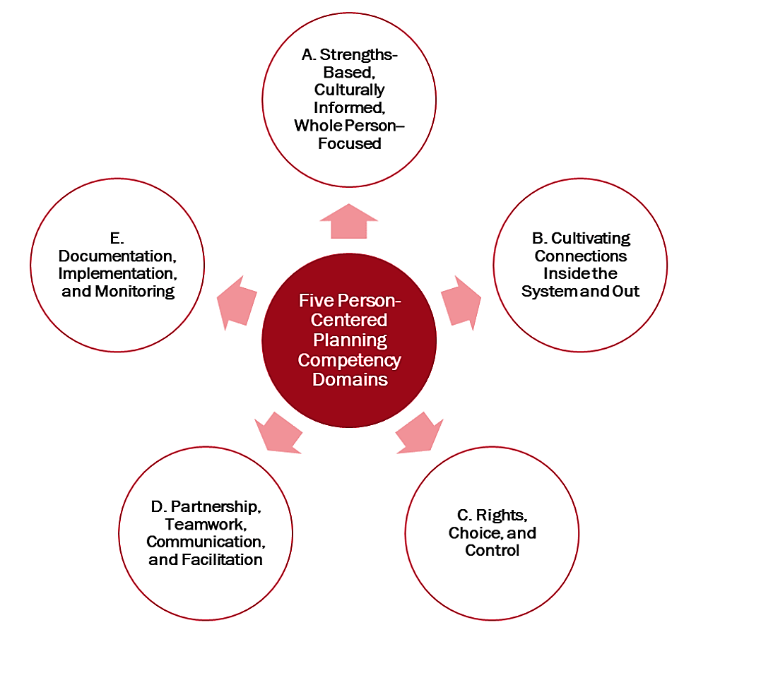
Needed Knowledge base: Person-centered planning
Service providers are “facilitators” of person-centered planning.
They need certain skills and abilities (competencies) to make person-centered planning work.
There are five competency domains that support an effective person-centered planning process.
Tondora, Croft, et al. (2020)
Tondora, Croft, et al. (2020)
Notes:
Using a Person-centered Planning Model is a way to learn about the choices and interests that make up a person’s idea of a good life—and to identify the supports needed to achieve that life. It is not something you do to a person, nor is it something you do for a person; instead, it is directed by the person, with support from a skilled “facilitator” as needed and desired. The facilitator might be a case manager, support coordinator, clinician, peer specialist, or another independent staff person who is specifically tasked with helping to co-create a person-centered plan.
Facilitators need certain skills and abilities to make person-centered planning work. These skills are also called “competencies.” There are five skill areas that facilitators should have. These skills support a good person-centered planning process. Let’s explore the five domains and associated competencies.
Tondora, J., Croft, B., et al. (2020, Nov.) Five competency domains for facilitators of person-centered planning. NCAPPS. https://ncapps.acl.gov/

Slide 16

Strengths-Based, Culturally Informed, Whole
Person–Focused
Demonstrate self-awareness and practice cultural humility; intentionally develop personal cultural competence skills.
Learn about a person’s cultural and linguistic preferences, values and beliefs, customs, and other cross-cultural differences.
Skillfully use planning techniques that foster goal discovery and self-direction.
Convey high expectations for meaningful outcomes across a broad range of quality-of-life areas.
Create a comprehensive, strengths-based profile with the person.
Tondora, Croft, et al. (2020)
Notes:
Person-centered planning recognizes that people grow, change, and can realize personally valued goals. PCP focuses on the universally valued goal of living a good life as defined by the person. All activities focus on the person as a whole (not just their diagnosis or disability) and are informed by the person’s unique culture and identity.
Skills
1. Demonstrate self-awareness and practice cultural humility. Person-centered practitioners must be cognizant of their own power and privilege, cultural assumptions, psychological development and temperament, personality dynamics, and prejudices to avoid imposing their beliefs on the process. Similarly, practitioners are aware of the values and cultural biases of the service system and recognize that the person’s values and culture may not align with the system’s values and culture.
2. Learn about a person’s cultural and linguistic preferences and experiences of trauma (personal or historical) and draw on this learning when partnering with the individual in the planning process. Recognize cultural and linguistic factors such as individualism and collectivism, language and communication, values and beliefs, customs and rituals, relationships to authority figures, avoidance of uncertainty, relationships to time, and other cross-cultural differences that need to be understood and respected in the person-centered planning process and its goal of community inclusion.
3. Skillfully use available person-centered tools to support goal discovery, visioning, and self-direction.
4. Convey high expectations for meaningful outcomes across a broad range of quality-of-life areas valued by the person that go far beyond the management of a disability or diagnosis.
5. Create a comprehensive, strengths-based profile with the person that helps them discover or rediscover themselves as a whole person with strengths and interests beyond their disability or diagnosis.
Tondora, J., Croft, B., et al. (2020, Nov.) Five competency domains for facilitators of person-centered planning. NCAPPS. https://ncapps.acl.gov/

Slide 17

Cultivating Connections Inside the System and Out
Understand the systems and supports a person may choose to access across a range of health, human services, employment, education, spiritual, cultural, and safety net areas.
Understand basic issues related to different populations served (age, gender, disabilities, etc.).
Promote the person’s connection to natural community supports and relationships that matter most to them.
Actively involve family caregivers and/or other supporters in accordance with the preferences of the person.
Support the right of the person to have a meaningful life in the community.
Tondora, Croft, et al. (2020)
Notes:
Planning facilitates linkages with both paid (professional) and unpaid (natural) supports. This requires understanding of the person’s relevant health or disability issues as well as knowledge of the array of systems the person may access. All activities seek to maximize connections to natural community activities and relationships in inclusive settings wherever possible and when consistent with the preferences of the person.
Skills
1. Understand the systems and supports a person may choose to access (e.g., LTSS) and facilitate linkages as appropriate, e.g., to health care, social services, entitlement programs, recreation and leisure, housing and employment supports, faith-based opportunities, employment resources, culturally specific resources, and safety net providers such as food pantries and clothing donations.
2. Understand basic issues related to different populations served, e.g., older adults and people with physical disabilities, intellectual/developmental disabilities, mental health challenges, brain injury, or Alzheimer’s disease or cognitive impairment.
3. Promote the person’s connection to natural community activities and relationships that matter most to them. Encourage a person’s experiences and activities beyond those provided in segregated environments designed only for people with disabilities or specific diagnoses.
4. Actively involve family caregivers and/or other supporters in collaboratively developing and executing the person-centered plan in accordance with the preferences of the person.
5. Support the creation or maintenance of a meaningful life in the community (as defined by each individual) as a fundamental human right and not something that must be earned by the demonstration of “stability” or acts of compliance with professional recommendations.
Tondora, J., Croft, B., et al. (2020, Nov.) Five competency domains for facilitators of person-centered planning. NCAPPS. https://ncapps.acl.gov/

Slide 18
Rights, Choice, and Control
Presume competence among persons served.
Understand the concepts of dignity and risk.
Provide basic education about rights, including the right to be free from discrimination.
Support people to advocate for themselves.
Practice supported decision-making using strategies to assist the person to make and communicate decisions about their life.
Understand and recognize abuse, neglect and exploitation, and how to handle these issues.
Tondora, Croft, et al. (2020)
Notes:
Relationships and planning activities are based on respect and the assumption that people are presumed competent and have the right to control decisions that impact their lives. Practitioners support people in empowering themselves and discovering their voice in all aspects of plan co-creation and implementation. Practitioners are aware of and able to educate people (when necessary and desired) about the range of legal protections that promote both fundamental safety (i.e., the right to be free from abuse and neglect) and community inclusion (i.e., the right to be free from discrimination and the right to exercise freedoms).
Skills
Presume competence. All people are presumed to have the capacity, and the right, to actively participate in the planning process.
Understand the concepts of dignity of risk and the right to fail. With the exception of some emergency situations, do not (directly or indirectly) place limits or restrictions on a person’s freedom or activities out of a desire to protect them or act in their best interest.
Provide basic education about one’s rights in services, as well as one’s right to be free from discrimination both within the service system and in the community at large.
Support people to advocate for themselves (and/or advocate for them when appropriate and desired) when their preferences or values are not being honored in the person-centered planning process and during times of tension or disagreement with providers or supporters.
Practice supported decision-making, a series of relationships, interventions, arrangements, and agreements designed to assist a person to make and communicate to others’ decisions about their life.
Understand how to recognize abuse, neglect, and exploitation and the legal and administrative requirements related to the handling and reporting of such violations.
Tondora, J., Croft, B., et al. (2020, Nov.) Five competency domains for facilitators of person-centered planning. NCAPPS. https://ncapps.acl.gov/

Slide 19
Partnership, Teamwork, Facilitation, and Coordination
Attend to language and respect the preferences of the person.
Respect the person’s input regarding the planning of meetings, areas for discussion, and preferences.
Facilitate meetings in a respectful and professional manner.
Make space for contribution of all team members, making sure the person’s voice is heard.
Understand and know how to work through conflicts.
Maintain a focus of the conversation on the person’s desired goals and outcomes.
Tondora, Croft, et al. (2020)
Notes:
Planning interactions and meetings are facilitated in a respectful, professional manner and in accordance with person-centered principles and the preferences of each individual. This ensures the primary focus remains on the priorities and perspective of the person. Support the person in expanding their team or circle as desired. Also, encourage all members to make meaningful contributions and facilitates the process in a way that is transparent and accessible to all parties involved.
Skills
Attend to language and respects the preferences of the person. Understand the nuances behind person-first vs. identity-first language.
Respect the person’s input regarding the planning meetings, including who the person would like to involve, preferences around logistics (location, schedule, etc.), priority areas for discussion, and preferences around facilitation (e.g., self-facilitated or supported).
Facilitate one-on-one or team meetings in a respectful, professional manner and work to ensure the person’s preferences shape the process.
Make space for the contributions of all team members during person-centered planning meetings, with a particular priority of making sure the person’s voice is not lost in the dialogue and is given primary consideration.
Understand and know how to help the person and their supporters identify and work through differences and conflicts. Be able to facilitate agreement, or respectful disagreement, among all involved on course of action using tools and techniques such as conflict resolution and decision support.
Maintain a focus in the conversation on the person’s desired life goals and outcomes.
Tondora, J., Croft, B., et al. (2020, Nov.) Five competency domains for facilitators of person-centered planning. NCAPPS. https://ncapps.acl.gov/

Slide 20
Person-Centered Plan Documentation, Implementation, and Monitoring
Actively include the person’s strengths, interests, and talents in their plan and its implementation.
Write plans using the person’s preferred name and language, and identity preferences throughout.
Frame goal statements using language that is clear and accessible.
Reflect the services and supports in plan documentation.
Solicit ongoing feedback from the person and their supporters on progress and concerns, making needed revisions to the plan.
Monitor and oversee the implementation of the plan.
Tondora, Croft, et al. (2020)
Notes:
The person-centered plan is co-created and captured in writing in a manner that adheres to established expectations around person-centered plan documentation. The plan is valued as a “living document” that is revised as needed based on the person’s preferences and evolving situation. There is responsible follow-up and monitoring of the plan’s implementation.
Skills
Actively include the person’s strengths, interests, and talents in their plan and its implementation.
Write plans using the person’s preferred name and language, and identity preferences throughout.
Frame goal statements using language that is clear and accessible while capturing what is important to the person in their own words wherever possible.
Reflect the services and supports (paid and unpaid) in plan documentation that will assist the person to achieve identified goals. If the person chooses, coordinate efforts between paid and unpaid (natural) supporters during plan implementation.
Solicit ongoing feedback from the person and their supporters on progress and concerns, and revise the plan as needed in an expedient manner.
Monitor and oversee the implementation of the plan to ensure that services are delivered both in accordance with the person’s preferences and in accordance with the type, scope, amount, duration, and frequency of supports as specified in the plan.
Tondora, J., Croft, B., et al. (2020, Nov.) Five competency domains for facilitators of person-centered planning. NCAPPS. https://ncapps.acl.gov/

Slide 21
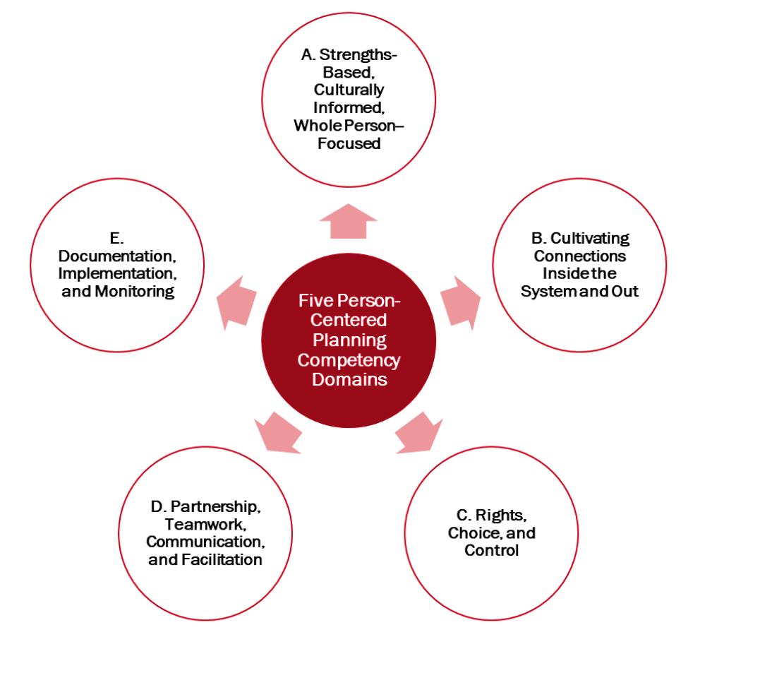
discussion
Based on the presentation of essential skills and abilities that are necessary to effectively facilitate person-centered planning in support of, and alongside, people receiving services…
WHAT AREAS DO YOU BELIEVE NEED THE MOST ATTENTION IN OUR ORGANIZATION TO PREPARE STAFF TO BE EFFECTIVE “FACILITATORS”?

Slide 22
Application to practice
Putting the Person First
and Respecting Diversity
of Needs
Notes:
IN THIS NEXT SECTION WE ARE GOING TO EXPLORE HOW THE CORE PRINCIPLE OF Putting the Person First and Respecting Diversity of Needs IS PUT INTO PRACTICE.

Slide 23

Federal impetus for person-centered care
Section 2402(a) of the Affordable Care Act (2010) requires all states receiving federal funds develop service systems that are responsive to the needs and choices of persons receiving home and community-based long-term services (HCBS), maximize independence and self-direction, provide support coordination to assist with a community-supported life, and achieve a more consistent and coordinated approach to the administration of policies and procedures across public programs.
Notes:
Section 2402(a) of the Affordable Care Act requires all states receiving federal funds develop service systems that are responsive to the needs and choices of persons receiving home and community-based long-term services (HCBS), maximize independence and self-direction, provide support coordination to assist with a community-supported life, and achieve a more consistent and coordinated approach to the administration of policies and procedures across public programs providing HCBS.
The agencies most directly affected by this guidance include:
• Administration for Community Living
• Centers for Medicare & Medicaid Services
• Health Resources and Services Administration
• Indian Health Service
• Substance Abuse and Mental Health Services Administration
• Administration for Children and Families
Since most publicly-funded services in our state receive some federal funding from one or more of these agencies, it is essential that services are developed and delivered in accordance with person-centered practices.
US Department of Health and Human Services (2014). Guidance to HHS Agencies for Implementing Principles of Section 2402(a) of the Affordable Care Act: Standards for Person-Centered Planning and Self-Direction in Home and Community-Based Services Programs.

Slide 24

Florida’s impetus for person-centered care
Section 394.4573, Florida Statutes, provides for a coordinated system of care, annual assessments, performance measures, system improvements, and reports.
The law references "no-wrong-door” language to emphasize that individuals come to treatment or other services through many pathways and follow diverse paths in recovery.
“No-wrong-door” refers to a model for the delivery of acute care services to persons who have mental health or substance use disorders, or both.
Notes:
In 2016, Florida law was augmented to specify that Florida’s behavioral health services are to be based on recovery-oriented principles (Ch. 2016-241, Laws of Florida). This legislation provided statutory support for the values and principles that underpin a recovery orientation, as well as the implementation of recovery-oriented practices throughout the State. Importantly, it fosters State priorities and regional differences while ensuring that communities and systems deliver high-quality care and services based on a recovery-orientation.
This legislation identified the “no-wrong-door” model of service delivery which increases access to behavioral health services allowing individuals to enter into the service system at a variety of access points and be connected with the most appropriate behavioral health services for their current needs. “No-wrong-door” refers to a model for the delivery of acute care services to persons who have mental health or substance use disorders, or both.
Florida’s services and supports system must ensure each person has the opportunity for meaningful choice and self-determination, and that civil and legal rights are affirmed and respected. Having a person-centered system where people are able to make informed choices, as we see, is a value and requirement that comes from various local, state and federal authorities.
Ch. 2016-241, Laws of Florida.

Slide 25

Resources for implementation of person-centered planning
NCAPPS is an initiative from the Administration for Community Living and the Centers for Medicare & Medicaid Services that helps States, Tribes, and Territories implement person-centered thinking, planning, and practice in line with U.S. Department of Health and Human Services policy.
NCAPPS partners with a host of national associations and subject matter experts to deliver knowledgeable and targeted technical assistance.
The National Center on Advancing Person-Centered Practices and Systems (NCAPPS)
Access the Center at https://ncapps.acl.gov
Notes:
With national and state focus on person-centered planning, many resources are now available to guide our way. Some are comprehensive and some provide a structure for planning methods.
The National Center on Advancing Person- Centered Practices and Systems (NCAPPS) is an initiative from the Administration for Community Living and the Centers for Medicare & Medicaid Services that helps States, Tribes, and Territories implement person-centered thinking, planning, and practice in line with U.S. Department of Health and Human Services policy. In the past 30 years, the support systems for older adults and people with disabilities have changed dramatically. In that time, long-term services and supports have generally moved to embrace person-centered values which are dedicated to the idea that individuals should have the power to define and pursue their own vision for a good life. However, many systems still struggle to put person-centered principles into practice and deliver on these commitments.

Slide 26

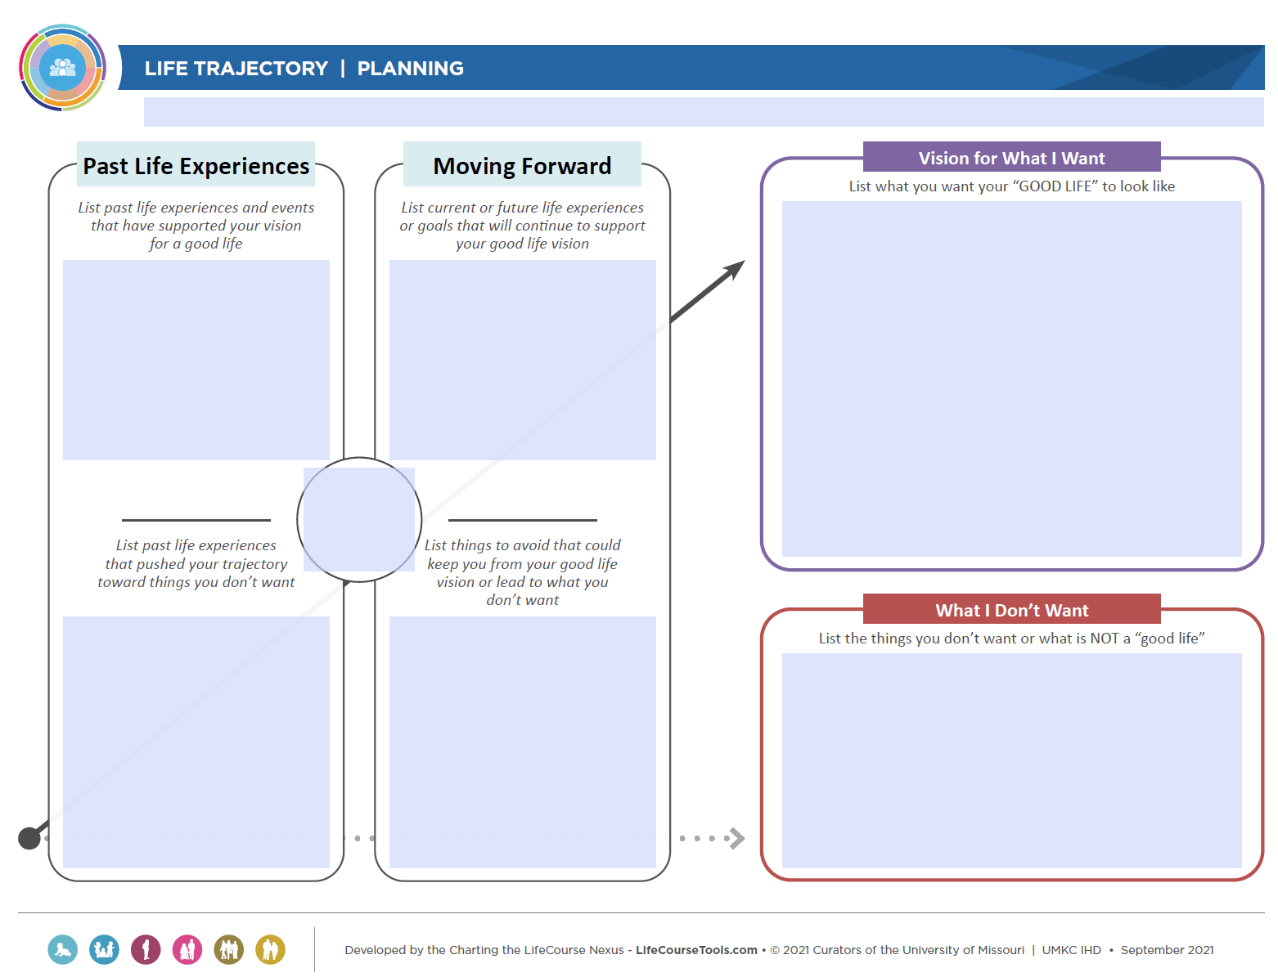
Resources for implementation of person-centered planning
The Charting the LifeCourse framework was developed by families to help individuals with disabilities and families at any age or stage of life develop a vision for a good life, think about what they need to know and do, identify how to find or develop supports, and discover what it takes to live the lives they want to live.
A variety of resources are available to facilitate visioning, planning, learning, etc.
https://www.lifecoursetools.com/
Notes:
The Charting the LifeCourse framework is led by the Institute for Human Development at the University of Missouri –Kansas City, a University Center for Excellence (UCEDD). The Charting the LifeCourse framework is designed to help organizations to assess, enhance, develop, and evaluate policies, practices and procedures to ensure person- and family-centered supports that lead to good lives. The CtLC principles and tools can be integrated into existing processes with individuals, families, and staff, and can also be used for supporting organizational strategic thinking and planning.

Slide 27
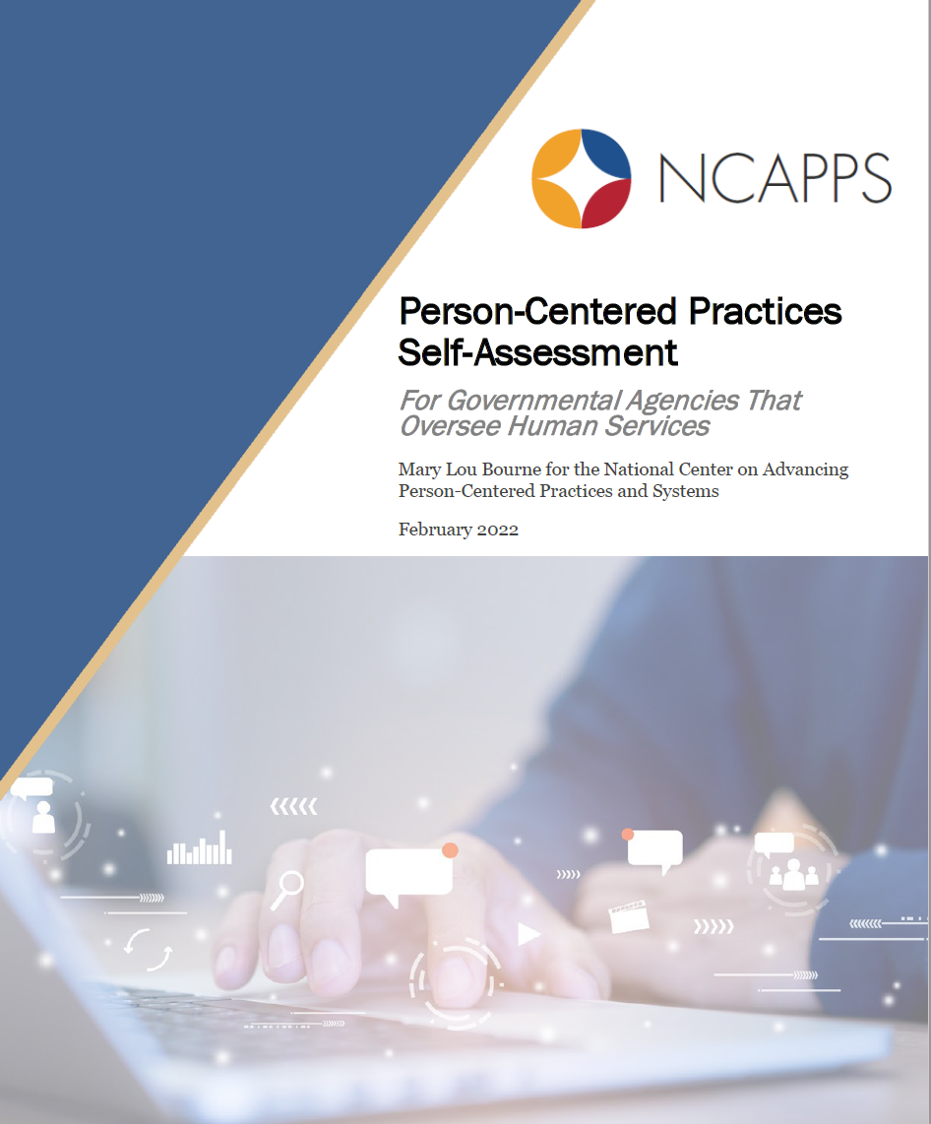
How do we move ahead?
First step: Conduct a Person-Centered Practices Self-Assessment
It measures progress in eight different domains:
  Leadership
  Person-Centered Culture
  Eligibility and Service Access
  Person-Centered Service Planning and Monitoring
  Finance
  Workforce Capacity and Capabilities
  Collaboration and Partnership
  Quality and Innovation
Notes:
With many resources to guide our way, it’s important to identify what the organization can do and what each individual can do to ensure we are “putting the person first” and meeting the diversity of needs. The first step can be an organizational self-assessment.
The Person-Centered Practices Self-Assessment was developed by the National Center on Advancing Person-Centered Practices and Systems. This Self-Assessment is designed to help leaders measure their progress in making human services systems more person-centered. It is designed for use by organizations that administer community-based services.
Once agency employees have completed the Self-Assessment independently, they can meet to review scores, discuss discrepancies, and come to agreement on a single agency score. It might also be useful to examine average and median scores as well as measures of spread (e.g., standard deviation) across different programs or staffing levels. Examining these differences might help you identify areas of excellence or opportunities to support areas for improvement.
The scores can also help you to develop a systems change plan. The plan should describe how you will develop changes to move your system to a score of five (excellent progress). For example, if you score a two in one area, your action plan will focus on how to implement the activities described in steps three or four. In this way, the Self-Assessment can help you decide where to focus limited energy and resources.
The Self-Assessment can be conducted periodically; the scores can help provide a picture of whether and how our agency is changing as we work toward greater levels of person-centered practice.
Bourne, M. L. (2020). NCAPPS Person-Centered Practices Self-Assessment. National Association of State Directors of Developmental Disabilities Services, Management Support Solutions, Inc., and Human Services Research Institute. Cambridge, MA: National Center on Advancing Person-Centered Practices and Systems.
3

Slide 28
Practices/actions for Organizations
Align
Align person-centered planning standards with organizational program and practice standards to embed the structure.
Commit
Make a commitment to advance policies and practices that put the person first and meet their diverse needs.
Create
Create an organization culture that believes in the ability and right of a person to make their own life decisions.
Support
Support staff to develop personal competencies as “facilitators” of person-centered care through ongoing training and supervision.
Measure
Establish goals for expanding or improving person-centered practices and culturally-responsive care; measure periodically.

Slide 29
Practices/Actions for staff
Explore
Explore your individual cultural competence; consider your skills, knowledge, and awareness in your interactions with others.
Continually build the knowledge, skills, and attitudes for effective facilitation of person-centered planning and service delivery.
Engage
Engage with the systems and supports a person may choose to access across a range health, human, and other service areas.
Use
Use an evidence-based, structured process for conducting person-centered planning actions, sessions, and documentation.
Advocate
Be an advocate for person-centered care/suggest creative strategies to address the needs and desires of the person.
Build

Slide 30
Questions for
Reflection
Putting the Person First
and Respecting Diversity
of Needs

Slide 31

Reflective Practice questions
Direct Service Providers: To what extent do you believe you align clinical or support services you deliver with culturally and linguistically competent, person-centered assessment, planning, and monitoring practices?
Managers: How has our agency engaged people of all cultural and ethnic backgrounds who use our services to be involved in program changes/new developments and have a valued role in providing feedback regarding our system?
Administrators: Can you describe how our mission, vision, and values connect directly to a set of standards that reflect person-centered policies, procedures, and practices in our service delivery?
Notes:
Review the reflective questions for the next time you meet.
Encourage the participants to focus on the reflective questions.

Slide 32
REFERENCES
Bourne, Mary Lou (2020). NCAPPS Person-Centered Practices Self-Assessment. National Association of State Directors of Developmental Disabilities Services, Management Support Solutions, Inc., and Human Services Research Institute. Cambridge, MA: National Center on Advancing Person-Centered Practices and Systems. https://ncapps.acl.gov/
Ch. 2016-241, Laws of Florida. http://www.leg.state.fl.us/statutes/index.cfm?App_mode=Display_Statute&URL=0300-0399/0394/Sections/0394.4655.html
Cross, T., Bazron, B., Dennis, K., & Isaacs, M. (1989). Towards a culturally competent system of care (Vol. 1). Washington, DC: Georgetown University Child Development Center, CASSP Technical Assistance Center.
Mental Health Commission of Canada (2015). Recovery Guidelines. Ottawa, ON.
Sanderson, H. (2000). Person-centered planning: Key features and approaches. http://www.familiesleadingplanning.co.uk/Documents/PCP%20Key%20Features%20and%20Styles.pdf

Slide 33
REFERENCES
Substance Abuse and Mental Health Services Administration (2014). Improving Cultural Competence. Treatment Improvement Protocol (TIP) Series No. 59. HHS Publication No. (SMA) 14-4849. Rockville, MD: SAMHSA.
Tondora, J., Croft, B., et al. (2020, Nov.) Five competency domains for facilitators of person-centered planning. NCAPPS. https://ncapps.acl.gov/
US Department of Health and Human Services (2014). Guidance to HHS Agencies for Implementing Principles of Section 2402(a) of the Affordable Care Act: Standards for Person-Centered Planning and Self-Direction in Home and Community-Based Services Programs. https://acl.gov/sites/default/files/programs/2017-03/2402-a-Guidance.pdf

Slide 34

THANK YOU!
Questions?

