Slide 1
Building an organizational Recovery-Oriented system of Care
A Seven-part series

Slide 2
training overview: Why are we here?
To recognize that, despite many difficult and life-changing experiences, recovery is possible for people with mental health and/or substance use conditions.
To identify beliefs, principles and practices that are critical in guiding our work to help those we serve rebuild meaningful, valued and satisfying lives.
Notes:
Experiencing serious mental health and/or substance use problems are a catastrophic and life-changing experiences. There is no way back to how things were before the problems started, but there is a way forward. Many people with mental health and substance use conditions have demonstrated that it is possible to rebuild a meaningful, valued, and satisfying life. Recovery is possible.
We know that people with mental health and substance use conditions benefit from a wide range of support and treatment, and it is critical that these are available to people of all ages and to those who may experience additional discrimination and disadvantage because of physical impairments, substance use problems, forensic history, learning disabilities, or their ethnicity, sexuality, or religion. A central question for any organization is whether this support and treatment helps the person to pursue their ambitions and make the most of their life. Therefore, the philosophy and principles guiding our work as behavioral health practitioners and the services provided are particularly important.

Slide 3
training overview: Why are we here?
Four key components of recovery:
Finding and maintaining hope
Addressing the personal aspects of recovery (a person’s life situation is to be viewed holistically, with practitioners partnering with individuals to build on their strengths and foster autonomy)
Building a meaningful life (recovery occurs with in the context of and alignment with the person’s life; family, friends, work, communities, etc.)
Affirming autonomy and personal responsibility to take control of one’s life
Notes:
There are many new understandings of the nature of substance use and mental health conditions, their management, and what contributes to recovery outcomes. At its most basic, research suggests that recovery comprises four key components, necessitating attention to each:
Finding and maintaining hope
Addressing the personal aspects of recovery (a person’s life situation is to be viewed holistically, with practitioners partnering with them to build on their strengths and foster autonomy)
Building a meaningful life (recovery occurs within the context of and alignment with the person’s life; family, friends, work, communities, etc.)
Affirming autonomy and personal responsibility to take control of one’s life
This is a training program for staff who provide a variety of services and support for persons with behavioral health conditions. Ultimately, it aims to support the development of a focus on recovery within our services. It provides different ideas for working with service users in a recovery-oriented fashion.
Jaiswal. A., Carmichael, K., Gupta, S., Siemens, T., et al (2020). Essential elements that contribute to the recovery of persons with severe mental illness: A systematic scoping study. Frontiers in Psychiatry (11). Retrieved from https://www.frontiersin.org/article/10.3389/fpsyt.2020.586230

Slide 4
training overview: goals
Develop a shared conceptual framework and language to transform our organization’s culture and practices.
Embrace the principles, values, knowledge, skills and behaviors that underlie recovery-oriented services and supports.
Explore a foundational approach to recovery-oriented care that can be adapted to the wide variety of services and supports provided by our organization.
Notes:
For a recovery-orientation to become an integral part of this organization, we must value, embrace and implement a “recovery orientation,” both in policy and in practice. This set of training modules and experiences is designed to help our staff understand recovery and to facilitate a consistent application of recovery principles to:
Develop a shared conceptual framework and language to transform our organization’s culture and practices.
Embrace the principles, values, knowledge, skills and behaviors that underlie recovery-oriented services and supports.
Explore a foundational approach to recovery-oriented care that can be adapted to the wide variety of services and supports provided by our organization.
In this training program, there may be elements in the language of “recovery” that do not immediately resonate with everyone. We expect, however, that in taking a foundational approach in looking at adapting to people’s needs, respecting people’s strengths and experiences, and adopting a holistic approach constitutes a solid basis for mutual understanding and learning from one another throughout this Recovery Management series. There will be many opportunities to reflect about the material presented and about how to align practices to best embody a recovery-oriented approach.

Slide 5
Structure of the course : 7 Modules
1. Recovery and Recovery Management
2. Engagement
3. Affirming Autonomy and Self-Determination
4. Putting the Person First & Respecting the Diversity of Needs
5. Comprehensive & Holistic Service Array
6. Focus on Strengths & Personal Responsibility
7. Supporting Social Inclusion & Advocacy

Slide 6
Structure of each Module
Core Principle
Values and Attitudes
What We Know From Research
Application of the Principle
Opportunities for Reflection
Notes:
Implementing recovery-oriented services involves learning about how to change practices, as well as reflecting about values, beliefs and ways of working together.
Core Principle – identifies a particular principle that is foundational to recovery-oriented practice. It frames the set of values, knowledge, skills, behavior and practice and are relevant to each module topic.
Values and Attitudes - those values, beliefs and attitudes held by individuals and organizations that shape or influence behavior
What We Know From Research – looks at current research and understanding of a particular principle and its relationship to recovery outcomes
Application of the Principle – expands on the knowledge area to advise how the principle and learnings are best applied within the organization and throughout the delivery of services
Activities & Opportunities for Reflection – These are intended to support individual practitioners’ efforts to translate recovery principles into their daily practice.
Throughout this course we emphasize how our organization and staff can embrace a recovery orientation and incorporate the types of recovery-focused services and supports that have been proven effective for persons with mental health and substance use conditions.
Mental Health Commission of Canada. (2015). Recovery Guidelines. Ottawa, ON: Author.

Slide 7
Recovery And Recovery management
Module 1

Slide 8
Module 1 Outline
Learning Objective 3
Examine the values surrounding recovery-oriented practice and implications for service delivery
3
Learning Objective 4
Introduce recovery management concepts and delineate factors for successful implementation
4
Learning Objective 2 Define recovery and explore recovery principles
2
Learning Objective 1 Review national and state movements in establishing a recovery-orientation for persons with mental health and substance use conditions
1
Notes:
This course identifies many knowledge needs, values, skills, services, and supports that are tied to recovery-oriented systems of care. Discuss the learning objectives for this module:
This module emphasizes that recovery is real. It is fueled by hope, facilitated by engagement, and guided by a set of principles.
In the course of this training, we will also offer practical examples of how behavioral health professionals and organizations can incorporate the types of recovery-focused services and supports that have been proven effective for persons with mental health and substance use conditions.
The culture and language of recovery-oriented practice communicates positive expectations and promotes hope for individuals we serve.

Slide 9
Core principle
Recovery orientation
Notes:
Let’s look at the current understanding of recovery for persons with behavioral health conditions and the principles that underpin a modern approach to recovery practices.

Slide 10
Timeline of the recovery Movement
1990s: The recovery movement was principally advanced by people with lived experience with either mental health or substance use conditions, caregivers and advocates who sought greater influence and control over their experiences in the service system.
2002: The New Freedom Commission on Mental Health created a transformational roadmap for excellence for caring for persons with mental health conditions.
2010: The Substance Abuse and Mental Health Services Administration (SAMHSA) advances many activities to foster a better understanding of recovery, recovery‐oriented practices, and the roles of the various professions in promoting recovery.
2016: The Surgeon General’s Report on Alcohol, Drugs, and Health: Facing Addiction in America (2016) is the first report to address substance use disorders and bring a modern understanding of recovery.
Notes:
Many advances have been made in the past several decades by persons in recovery and national initiatives to promote recovery concepts and practices. These initiatives have fostered a better understanding of recovery, recovery‐oriented practices, and the roles of the various professions in promoting recovery. The recovery movement evolved from the early work of disability rights advocates who argued for inclusion of individuals and their families in the planning and service delivery process and argued that people with disabilities should be considered full members of their community and the larger society. These efforts also paralleled those of the civil rights movement that was working for inclusion and full citizenship for people from all races and cultures.
Recovery movements were principally advanced by people with lived experience with either mental health or substance use conditions, caregivers and advocates whose successful efforts culminated in the push for better research and development of service delivery systems that are respectful and include the persons served as decision makers.
Federal initiatives followed with:
the federal New Freedom Commission on Mental Health detailed a transformational roadmap to achieve the promise of excellence in mental health care in 2003;
The Substance Abuse and Mental Health Services Administration’s (SAMHSA) decade of work to develop recovery concepts and provide funding to support their efforts;
The Surgeon General’s Report on Alcohol, Drugs, and Health: Facing Addiction in America (2016) is the first report to address substance use disorders and the wider range of health problems
These changes are profound and are based on new understandings of the nature of substance use and mental health conditions and their management.
New Freedom Commission on Mental Health (2003). Achieving the Promise: Transforming Mental Health Care in America. Final Report. DHHS Pub. No. SMA-03-3832. Rockville, MD.
U.S. Department of Health and Human Services, Office of the Surgeon General (Nov. 2016). Facing Addiction in America: The Surgeon General’s Report on Alcohol, Drugs, and Health. Washington, DC: HHS. https://addiction.surgeongeneral.gov/

Slide 11
Recovery
“Recovery is a process of change whereby individuals improve their health and wellness, to live a self-directed life, and strive to reach their full potential.” Substance Abuse and Mental Health Services Administration (2014).
Notes:
There are many definitions of recovery. Most definitions of recovery found in the behavioral health literature involve some component of acceptance of illness, having a sense of hope about the future, and finding a renewed sense of self. In 2012, persons in recovery in the United States collaborated with the Substance Abuse and Mental Health Services Administration (SAMHSA) to create a modern definition of recovery for behavioral health conditions – “Recovery is a process of change whereby individuals improve their health and wellness, to live a self-directed life, and strive to reach their full potential” (SAMHSA, 2014).
To avoid confusion and to bridge the differences between mental health and substance use perspectives, this training program strives wherever possible to use the term recovery broadly, that is, to focus on the whole person not just a disorder, condition, or related behaviors.
Substance Abuse and Mental Health Services Administration (SAMHSA, 2014). Recovery and Recovery Support. https://www.samhsa.gov/find-help/recovery#:~:text=SAMHSA's%20working%20definition%20of%20recovery,to%20reach%20their%20full%20potential.
Davidson, L., O’Connel, M.J., Staeheli, M., Weingarten, R. et al. (2001). Concepts of recovery in behavioral health: History, review of the evidence, and critique. Psychiatric Services, 52(4), 482-5.

Slide 12
Distinctions in recovery definition
Distinctions have been made within the definition of recovery
The distinctions include:
Clinical recovery (symptom remission or abstinence)
Functional recovery (getting a job and coping with daily life demands)
Personal recovery (improvements in wellbeing and life satisfaction, regaining a positive sense of identity)
Social recovery (developing strong and supportive social networks)
Notes:
Distinctions have been made within the definition of recovery to differentiate between:
clinical recovery (symptom remission or abstinence)
functional recovery (getting a job and coping with daily life demands)
personal recovery (improvements in wellbeing and life satisfaction, regaining a positive sense of identity)
social recovery (developing strong and supportive social networks)
This yields a recovery process unique to each person. For many people with mental health and substance use conditions, the concept of recovery is about staying in control of their life. Such an approach, which does not focus on full symptom resolution but emphasizes resilience and control over problems and life, has been called the recovery model. Recovery does not mean a cure. It’s not about ceasing to need support – it’s about “recovering a life,” the right to participate in all facets of civic and economic life as an equal citizen.
Roosenschoon, B. J., Kamperman, A. M., Deen, M. L., Weeghel, J. V., & Mulder, C. L. (2019). Determinants of clinical, functional and personal recovery for people with schizophrenia and other severe mental illnesses: A cross-sectional analysis. PloS one, 14(9), e0222378. https://doi.org/10.1371/journal.pone.0222378

Slide 13
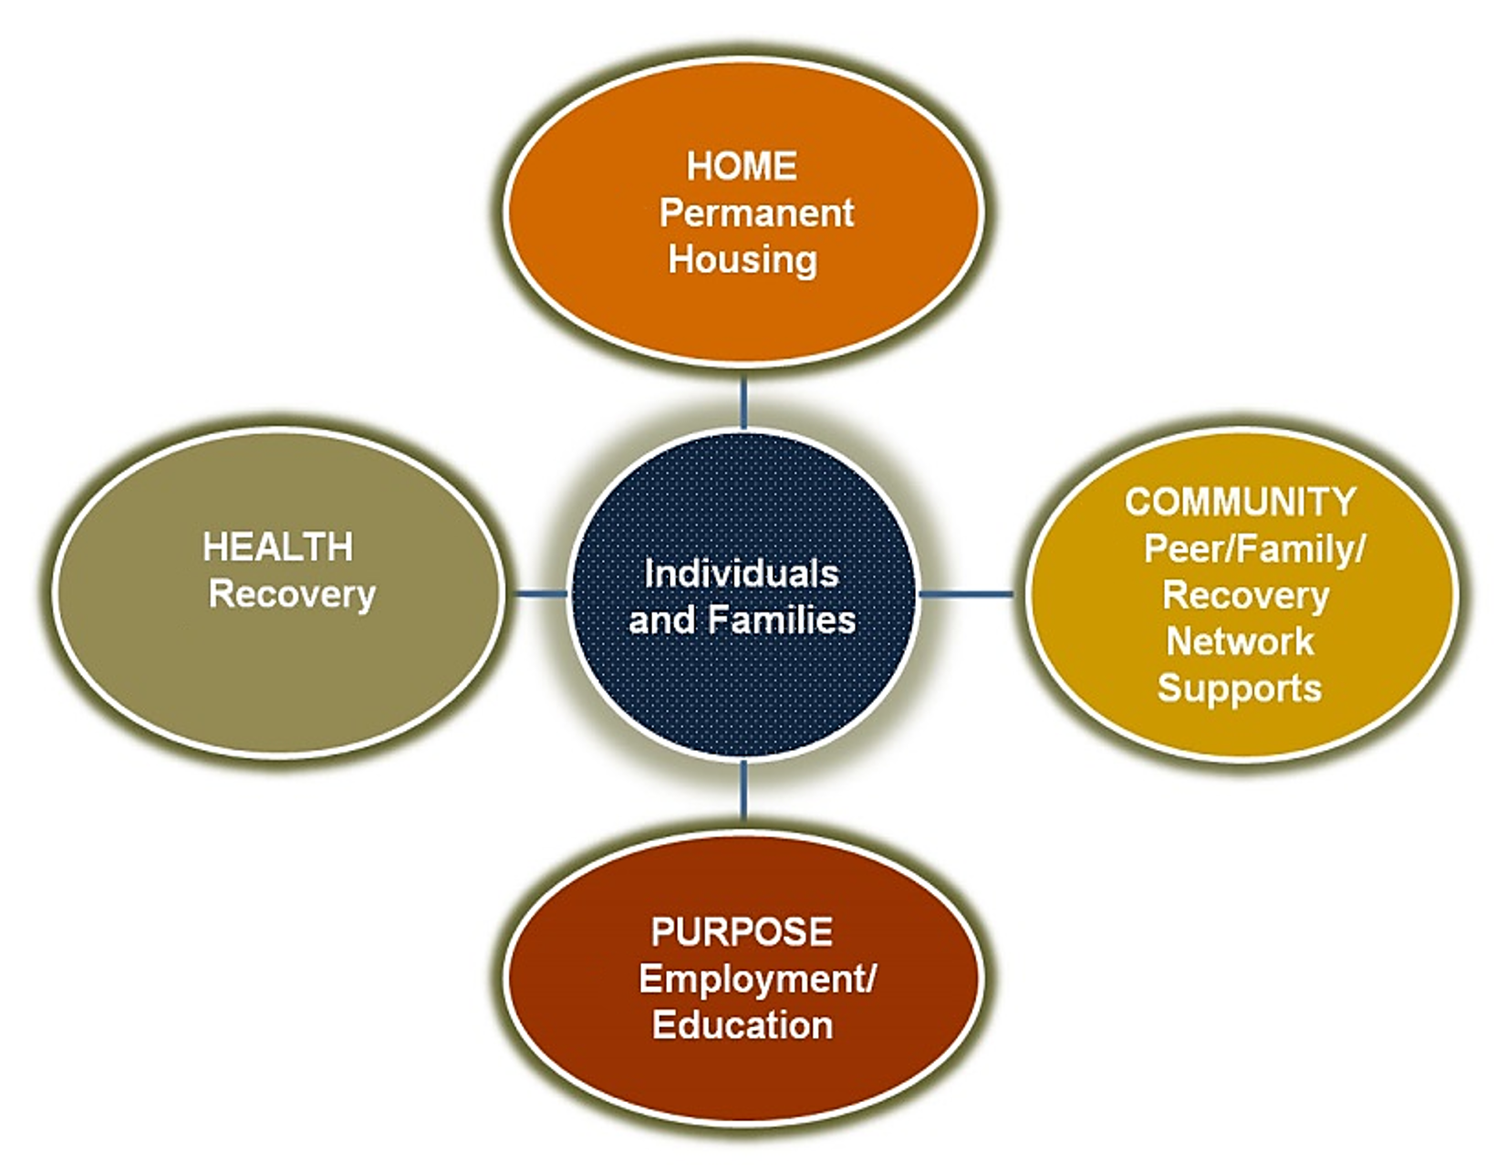
SAMHSA has distinguished four areas that support a life in recovery.
RECOVERY DIMENSIONS
Notes:
SAMHSA has delineated four major dimensions that support a life in recovery:
Health: overcoming or managing one’s disease(s) as well as living in a physically and emotionally healthy way
Home: a stable and safe place to live
Purpose: meaningful daily activities, such as a job, school, volunteerism, family caretaking, or creative endeavors, and the independence, income and resources to participate in society
Community: relationships and social networks that provide support, friendship, love, and hope.
Hyde, P. (2011). Shaping the Future: Challenges and Opportunities (conference presentation). Washington, DC: SAMHSA.

Slide 14
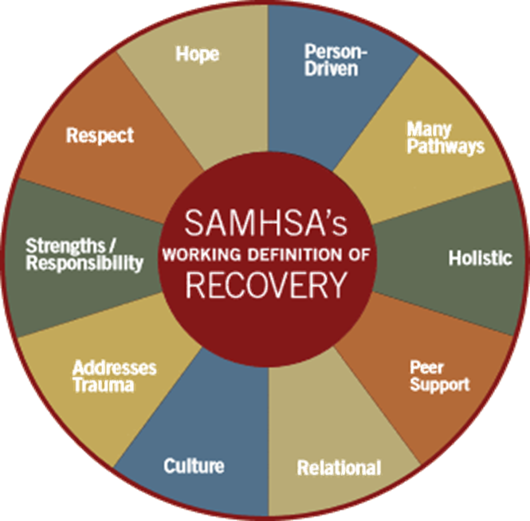
10 Recovery principles
Recovery emerges from hope: The belief that recovery is real provides the essential and motivating message of a better future.
Recovery is person-centered: Self-determination and self-direction are the foundations for recovery as individuals define their own life goals and design their unique path(s) towards those goals.
Recovery occurs via many pathways: Recovery pathways are highly personalized. Recovery is non-linear, characterized by continual growth and improved functioning that may involve setbacks.
Recovery is holistic: Recovery encompasses an individual’s whole life, including mind, body, spirit, and community.
Notes:
There are several principles upon which the concept of recovery is based. SAMHSA, in collaboration with persons in recovery, has also created a set of guiding values and principles that have come to be commonly accepted as the standards for effective delivery of recovery-focused care.
Recovery emerges from hope: The belief that recovery is real provides the essential and motivating message of a better future—that people can and do overcome the internal and external challenges, barriers, and obstacles that confront them.
Recovery is person-centered: Self-determination and self-direction are the foundations for recovery as individuals define their own life goals and design their unique path(s) towards those goals.
Recovery occurs via many pathways: Recovery is built on the multiple capacities, strengths, talents, coping abilities, resources, and inherent value of each individual. Recovery pathways are highly personalized. Recovery is non-linear, characterized by continual growth and improved functioning that may involve setbacks.
Recovery is holistic: Recovery encompasses an individual’s whole life, including mind, body, spirit, and community. The array of services and supports available should be integrated and coordinated.
SAMHSA (2012). SAMHSA’s working definition of recovery. Washington, DC: US Department of Health and Human Services, SAMHSA. https://store.samhsa.gov/product/SAMHSA-s-Working-Definition-of-Recovery/PEP12-RECDEF

Slide 15
10 Recovery principles
Recovery is supported by peers and allies: Mutual support and mutual aid groups play an invaluable role in recovery. Peers encourage and engage other peers and provide each other with a vital sense of belonging, supportive relationships, valued roles, and community.
Recovery is supported through relationship and social networks: An important factor is the presence and involvement of people who believe in the person’s ability to recover. Family members, peers, providers, faith groups, community members, and other allies form vital support networks.
Recovery is culturally-based and influenced: Culture and cultural background - including values, traditions, and beliefs - are keys in determining a person’s journey and unique pathway to recovery.
Notes:
Recovery is supported by peers and allies: Mutual support and mutual aid groups play an invaluable role in recovery. Peers encourage and engage other peers and provide each other with a vital sense of belonging, supportive relationships, valued roles, and community. Professionals also play an important role in the recovery process by providing clinical treatment and other services that support individuals in their chosen recovery paths.
Recovery is supported through relationship and social networks: An important factor in the recovery process is the presence and involvement of people who believe in the person’s ability to recover; who offer hope, support, and encouragement; and who also suggest strategies and resources for change. Family members, peers, providers, faith groups, community members, and other allies form vital support networks.
Recovery is culturally-based and influenced: Culture and cultural background - including values, traditions, and beliefs - are keys in determining a person’s journey and unique pathway to recovery. Services should be culturally grounded, attuned, sensitive, congruent, and competent, as well as personalized to meet each individual’s unique needs.
SAMHSA (2012). SAMHSA’s working definition of recovery. Washington, DC: US Department of Health and Human Services, SAMHSA. https://store.samhsa.gov/product/SAMHSA-s-Working-Definition-of-Recovery/PEP12-RECDEF

Slide 16
10 Recovery principles
Recovery is supported by addressing trauma: Services and supports should be trauma-informed to foster safety (physical and emotional) and trust, as well as promote choice, empowerment, and collaboration.
Recovery involves individual, family, and community strengths and responsibility: Individuals have a personal responsibility for their own self-care and journeys of recovery. Families and significant others have responsibilities to support their loved ones, especially for children and youth in recovery.
Recovery is based on respect: Community, systems, and societal acceptance and appreciation for people affected by mental health and substance use disorders are crucial in achieving recovery. Self-acceptance, developing a positive and meaningful sense of identity, and regaining belief in oneself are particularly important.
Notes:
Recovery is supported by addressing trauma: The experience of trauma (such as physical or sexual abuse, domestic violence, war, disaster, and others) is often a precursor to or associated with substance use, mental health problems, and related issues. Services and supports should be trauma-informed to foster safety (physical and emotional) and trust, as well as promote choice, empowerment, and collaboration.
Recovery involves individual, family, and community strengths and responsibility: Individuals, families, and communities have strengths and resources that serve as a foundation for recovery. Individuals have a personal responsibility for their own self-care and journeys of recovery. Families and significant others have responsibilities to support their loved ones, especially for children and youth in recovery.
Recovery is based on respect: Community, systems, and societal acceptance and appreciation for people affected by mental health and substance use disorders – including protecting their rights and eliminating discrimination – are crucial in achieving recovery. Self-acceptance, developing a positive and meaningful sense of identity, and regaining belief in one’s self are particularly important.
SAMHSA (2012). SAMHSA’s working definition of recovery. Washington, DC: US Department of Health and Human Services, SAMHSA. https://store.samhsa.gov/product/SAMHSA-s-Working-Definition-of-Recovery/PEP12-RECDEF

Slide 17
Recovery principles and change
The overarching goal for these recovery principles is to protect the process of recovery that is unique to each person.
For many individuals with behavioral health conditions, the concept of recovery is about staying in control of their life and achieving a better quality of life.
The new recovery philosophy challenges not only how we view individuals with these disorders, but how we design and deliver services.

Slide 18
QuestionS?
Which of the recovery principles and values resonate most with you?
Why are these important?

Slide 19
Values & attitudes
Recovery orientation

Slide 20
Do we?…Do You?…
Believe that hope is the foundation on which a journey of recovery is built?
Respect and value a person’s inherent worth and importance?
Believe in a person’s capacity to recover, thrive and lead a meaningful and contributing life?
Agree to celebrate each person’s effort and achievements?
Commit to embedding optimism and the expectation of positive outcomes in language, relationships and service delivery?
Notes:
While many common elements exist throughout the mental health and substance use disorder systems, there are significant differences in ideologies, practices, and procedures that may present barriers to supporting the SAMHSA-identified principles of recovery.
A barrier to implementing recovery-oriented systems that integrate mental health and substance use disorder systems is different understandings of the meanings of language used to describe recovery, recovery-oriented systems of care, and recovery support systems. Between mental health and substance use disorder systems, these terms are commonly used; however, the words have different meanings within each of these systems.
It is important to determine whether the differences reside in the words or with personal values. Either way, common ground must be sought and nurtured in order to successfully integrate services and systems and develop viable recovery-oriented systems.
Note to trainer: Pose these questions to the learners from the perspective of the organization and as an individual. Foster a discussion about values and attitudes that surround these statements. As a counterpoint - Ask what attitudes may be opposed to these values.

Slide 21
How Do we?…How Do You?…
WHERE’S THE EVIDENCE?
Foster hope as the foundation on which a journey of recovery is built?
Show respect and value each person?
Believe in a person’s capacity to recover, thrive and lead a meaningful and contributing life?
Demonstrate a recovery orientation built upon optimism and the expectation of positive outcomes?
Notes:
Look at these statements from the perspective of the organization and as an individual. Foster a discussion about where these values and practices can be found within the organization. Don’t ask what needs to be done at this time; this question will be posed at the end of the module.

Slide 22
What we know From research
Recovery orientation

Slide 23
RECOVERY-ORIENTED SYSTEM OF CARE
A Recovery-Oriented System of Care (ROSC) is person-centered and wellness-focused, and builds on the strengths and resources of the individual, his/her/their family and community to promote overall improvements in functioning.
Notes:
A ROSC encompasses a menu of individualized, person-centered, and strength-based services within a self-defined network. By design, a ROSC provides individuals and families with more options with which to make informed decisions regarding their care. Services are designed to be accessible, welcoming, and easy to navigate. A fundamental value of a ROSC is the involvement of people in recovery, their families, and the community to continually improve access to and quality of services.
SAMHSA (2010). Recovery-Oriented Services Guide. https://www.samhsa.gov/sites/default/files/rosc_resource_guide_book.pdf

Slide 24
a Recovery- oriented focus ShiftS practice in three ways…
The way individuals in recovery are viewed.
The way services are designed to be comprehensive and holistic.
The way service delivery aligns more closely with the individual and the specific needs of that individual.

Slide 25
FLORIDA ROSC INITIATIVES
Established state goals include:
Promote good quality of life, community health, and wellness for all.
Prevent the development of behavioral health conditions.
Intervene earlier in the progression of illnesses.
Reduce the harm caused by substance use disorders and mental health conditions on individuals, families, and communities.
Provide the resources to assist people with behavioral health conditions to achieve and sustain their wellness and build meaningful lives for themselves in their communities.
Chapter 2016-241, Laws of Florida, provides that Florida’s behavioral health services are based on recovery-oriented principles.
Notes:
In 2016, Florida law was augmented to specify that Florida’s behavioral health services are to be based on recovery-oriented principles (Ch. 2016-241, Laws of Florida). This legislation provided statutory support for the values and principles that underpin a recovery orientation as well as the implementation of recovery-oriented practices throughout the State. Importantly, it fosters State priorities and regional differences while ensuring that communities and systems deliver high-quality care and services based on a recovery-orientation.
At the state and local levels, Florida has been working in establishing a network of clinical and nonclinical services and supports to sustain long-term, community-based recovery. As local entities, ROSCs are implementing the guiding principles of recovery orientation while reflecting the unique variations in each community’s vision, institutions, resources, and priorities. Behavioral health systems and communities form ROSCs to:
Promote good quality of life, community health, and wellness for all.
Prevent the development of behavioral health conditions.
Intervene earlier in the progression of illnesses.
Reduce the harm caused by substance use disorders and mental health conditions on individuals, families, and communities; and
Provide the resources to assist people with behavioral health conditions to achieve and sustain their wellness and build meaningful lives for themselves in their communities.
Florida Department of Children and Families. Recovery-Oriented System of Care. https://www.myflfamilies.com/service-programs/samh/rosc/index.shtml

Slide 26
What does this mean for our organization?
Secure the best alignment with state mandates and ROSC principles.
Ensure that service funding and community resources are used to reach the highest level of health and functioning of the individuals and families we serve.
Review the structure and delivery of services and support for people we serve to meet individuals’ expectations, recovery goals, and unique needs.
Prepare staff to deliver services in accordance with these objectives.
Notes:
Discuss these overarching objectives, but add any specific objectives or examples from within your organization.

Slide 27
Adopting a “recovery management” stance
Recovery Management is an approach which includes a variety of activities that promote and strengthen internal and external resources to help individuals secure the services they need to stabilize behavioral health conditions and maintain healthy levels of functioning.
Recovery Management is based on the belief that recovery is seldom achieved from a single episode of intervention or treatment, and that practitioners, as well as individuals in recovery, families, and policymakers, should not be disappointed or discouraged by the fact that there may be no quick fixes.
Notes:
Recovery management is basically the stewardship of personal, family and community resources to achieve the highest level of health and functioning of individuals and families impacted by behavioral health conditions. It is a time-sustained, recovery focused collaboration between service users and traditional and non-traditional service providers toward the goal of stabilizing, and then actively managing the ebb and flow of substance use and mental health conditions until remission and recovery has been achieved, or until conditions can be effectively self-managed by the individual and their family.
Recovery management is based on the belief that full recovery is seldom achieved from a single episode of intervention or treatment, and that practitioners, as well as people in recovery, families, and policy makers, should not be disappointed or discouraged by the fact that there are no quick fixes. Reoccurrence(s) in substance use or of mental health symptoms are viewed as evidence of the severity of the person’s condition rather than as causes for discharge. The recovery management model acknowledges this vulnerability but suggests that such reoccurrences are not inevitable if the ongoing recovery process is actively managed.
The public health community has long practiced recovery management when treating chronic diseases such as diabetes, asthma, and hypertension. While public health care providers may use different terminology, recovery management is a tool embedded in their approach to practice. Public health principles address health promotion through comprehensive prevention strategies, screening, early intervention, treatment, and reinforcement of healthy lifestyles.
White, W. L., Boyle, M. G., Loveland, D. L. & Corrington, P. W. (n.d.). What is behavioral health recovery management? A brief primer. Fayette Companies, Chestnut Health Systems and The University of Chicago Center for Psychiatric Rehabilitation. http://www.bhrm.org/media/pdf/pub/BHRM_Primer.pdf

Slide 28
Rosc recovery management system
Shifts the service orientation from an intensive short-term mode to a service commitment of long-term supports and wellness
Focuses on providing a full spectrum of care
Coordinates access to resources
Changes within multiple layers of the organization
Affects each layer within the organization to address challenges and barriers to policy and procedure implementation (ROSC Guidelines, 2010)
Notes:
Traditionally, recovery-oriented services have been viewed as long-term recovery related activities that occur after a formal substance use treatment episode. However, recovery-oriented activities and approaches are also part of the full continuum of care available to persons within a ROSC. A ROSC provides a network of services and supports to address the full spectrum of substance use problems, from harmful use to chronic conditions.
SAMHSA (2010). Recovery-Oriented Services Guide. https://www.samhsa.gov/sites/default/files/rosc_resource_guide_book.pdf

Slide 29
Recovery management - full spectrum of services
Pre-service identification and engagement
Recovery initiation and stabilization (recovery activities/treatment)
Recovery maintenance (post-treatment recovery support services)
Notes:
Recovery management spans three phases in the recovery process:
pre-service identification and engagement,
recovery initiation and stabilization (recovery activities/treatment), and,
recovery maintenance (post-treatment recovery support services).
A ROSC supports the premise that there are many pathways to recovery. Recovery-oriented activities include providing a menu of traditional treatment services and alternative therapies, including peer recovery coaching, acupuncture, meditation, and music and art therapy. Recovery support services, including employment assistance, childcare, care management and housing support, may enhance the engagement of individuals and their families in achieving and sustaining recovery.

Slide 30
Application to practice
Recovery Orientation

Slide 31
Transformation: Building blocks
Aligning treatment and recovery support services
Providing individualized and high-quality services
Integrating recovery support services
Developing meaningful connections with peers
Building a network of recovery-oriented services
Facilitating processes and partnerships
Aligning administrative structures and policies to support a recovery-oriented system

Slide 32
Helpful tool to structure actions
Recovery-Oriented Principles (CONNECT)
Practices (HOPE)
Mnemonic device: a memory technique that can help increase your ability to recall and retain information.
CONNECT & HOPE
Notes:
Throughout this course, the principles of recovery and ROSC will be repeated, examined and reinforced. Much of this information and way of thinking is new to service providers. We are introducing here a helpful mnemonic device which is a memory technique that can help increase your ability to recall and retain information.
CONNECT: Since most of a person’s recovery journey occurs outside the behavioral health service system, fostering recovery necessitates understanding people within the context of their lives. Family, friends, neighbors, local community, schools, workplaces, spiritual, and cultural communities all influence recovery outcomes and well-being. Recovery-oriented practice works with people in learning how to navigate their own path through the web of family, community and society.
HOPE: Hope is the foundation on which a journey of recovery is built. Hope is not an abstract concept, nor is it an unreasonable expectation. At its core, being hopeful means holding an expectation for positive development. Hope helps provide the motivation and sustain the strength required.
A recovery approach focuses on the values, hopes and dreams of each person, while never losing sight of the impact of the social context on people’s lives. Feeling positive about the future contributes to everyone’s mental health and well-being. A lack of hope can limit a person’s ability to recover.
Mental Health Commission of Canada. (2015). Recovery Guidelines Ottawa, ON: Author. https://www.mentalhealthcommission.ca/wp-content/uploads/drupal/MHCC_RecoveryGuidelines_ENG_0.pdf

Slide 33
The Action plan: Connect To Hope
Recovery-Oriented Principles (CONNECT)
Practices (HOPE)
Create a culture and language and hope
Offer a comprehensive and holistic service array
Non-judgmental
Navigating diverse needs
Engagement strategies
Collaborative relationships and reflective practice
Transforming services and systems
Honor the differences and diverse needs of each individual served
Offer various opportunities and resources that support the recovery journey
Provide an environment to encourage personal control
Engage in personal recovery by understanding personal recovery narrative in the treatment process and within the community
Notes:
Ideas for change and action plans for change can be constructed using the CONNECT (principles) to HOPE (practice) framework.

Slide 34
Activity
Break into groups. Reflect on the key principles that contribute to an intentional recovery focus for services and supports.
Discuss the following:
What are some ways you have noted that our organization can increase its use of recovery-oriented practices? Please describe them.

Slide 35
Questions for Reflection
Recovery Orientation

Slide 36
Reflective practice
Please reflect on the following questions and write down your responses.
Direct Service provider: What impact does an intentional recovery focus have on your day-to-day work? How do you model “hope” and create a climate of optimism/encourage positive outcomes with the people you serve?
Management: Consider the transformation process towards a Recovery-Oriented System. What are your strengths? What do you want to work on first within the framework? What are your challenges and barriers?
Administrative (to include support staff): How welcoming are you when someone in need of help calls or comes through our door? Do you practice patience for a lost individual? How can you be an extension of the ROSC framework?

Slide 37
references
Davidson, L., O’Connel, M.J., Staeheli, M., Weingarten, R., et al. (2001). Concepts of recovery in behavioral health: History, review of the evidence, and critique. Psychiatric Services, 52(4), 482-5.
Florida Department of Children and Families. Recovery-Oriented System of Care (website). https://www.myflfamilies.com/service-programs/samh/rosc/index.shtml
Hyde, P. (2011). Shaping the Future: Challenges and Opportunities (conference presentation). Washington, DC: SAMHSA.
Jaiswal. A., Carmichael, K., Gupta, S., Siemens, T., et al (2020). Essential elements that contribute to the recovery of persons with severe mental illness: A systematic scoping study. Frontiers in Psychiatry (11). Retrieved from https://www.frontiersin.org/article/10.3389/fpsyt.2020.586230
Mental Health Commission of Canada. (2015). Recovery Guidelines. Ottawa, ON: Author. https://www.mentalhealthcommission.ca/wp-content/uploads/drupal/MHCC_RecoveryGuidelines_ENG_0.pdf
New Freedom Commission on Mental Health (2003). Achieving the Promise: Transforming Mental Health Care in America. Final Report. DHHS Pub. No. SMA-03-3832. Rockville, MD.

Slide 38
references
SAMHSA. Recovery and Recovery Support. https://www.samhsa.gov/find-help/recovery#:~:text=SAMHSA's%20working%20definition%20of%20recovery,to%20reach%20their%20full%20potential .
Roosenschoon, B. J., Kamperman, A. M., Deen, M. L., Weeghel, J. V., & Mulder, C. L. (2019). Determinants of clinical, functional and personal recovery for people with schizophrenia and other severe mental illnesses: A cross-sectional analysis. PloS one, 14(9), e0222378. https://doi.org/10.1371/journal.pone.0222378
SAMHSA (2012). SAMHSA’s working definition of recovery. Washington, DC: US Department of Health and Human Services, SAMHSA. https://store.samhsa.gov/product/SAMHSA-s-Working-Definition-of-Recovery/PEP12-RECDEF
SAMHSA (2010). Recovery-Oriented Services Guide. https://www.samhsa.gov/sites/default/files/rosc_resource_guide_book.pdf
U.S. Department of Health and Human Services, Office of the Surgeon General (Nov. 2016). Facing Addiction in America: The Surgeon General’s Report on Alcohol, Drugs, and Health. Washington, DC: HHS. https://addiction.surgeongeneral.gov/
White, W. L., Boyle, M. G., Loveland, D. L. & Corrington, P. W. (n.d.). What is behavioral health recovery management? A brief primer. Fayette Companies, Chestnut Health Systems and The University of Chicago Center for Psychiatric Rehabilitation. http://www.bhrm.org/media/pdf/pub/BHRM_Primer.pdf

Slide 39
THANK YOU!
Questions?

